Slide 1
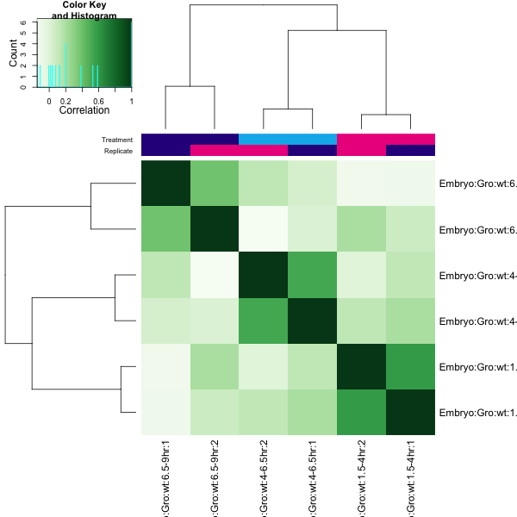
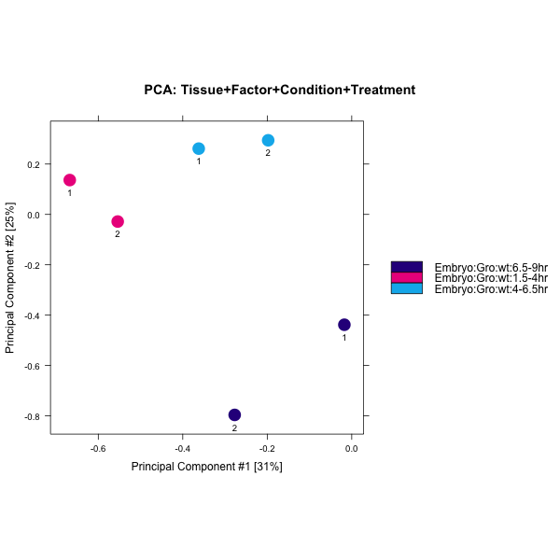
A
B
C

Slide 2
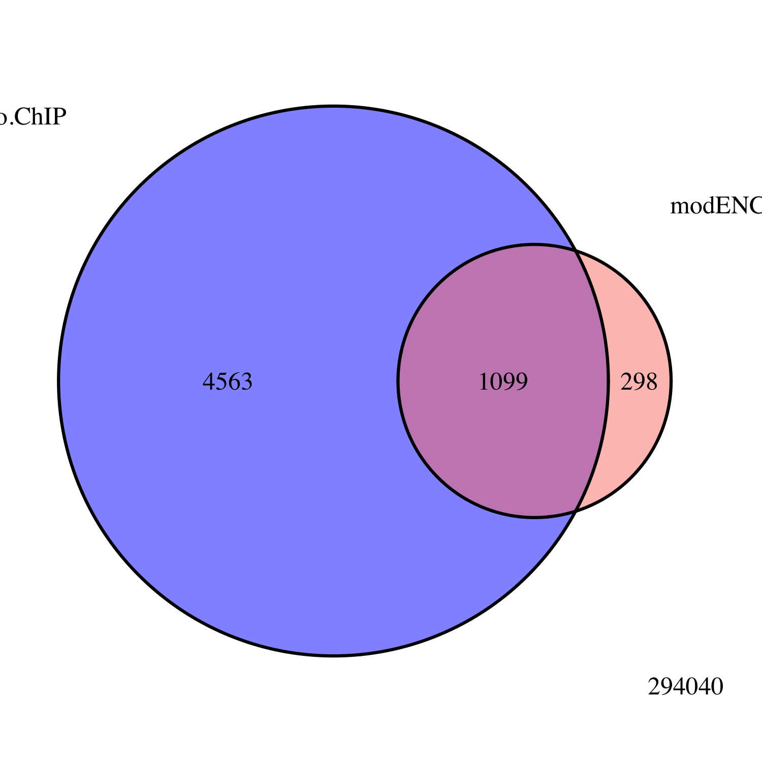
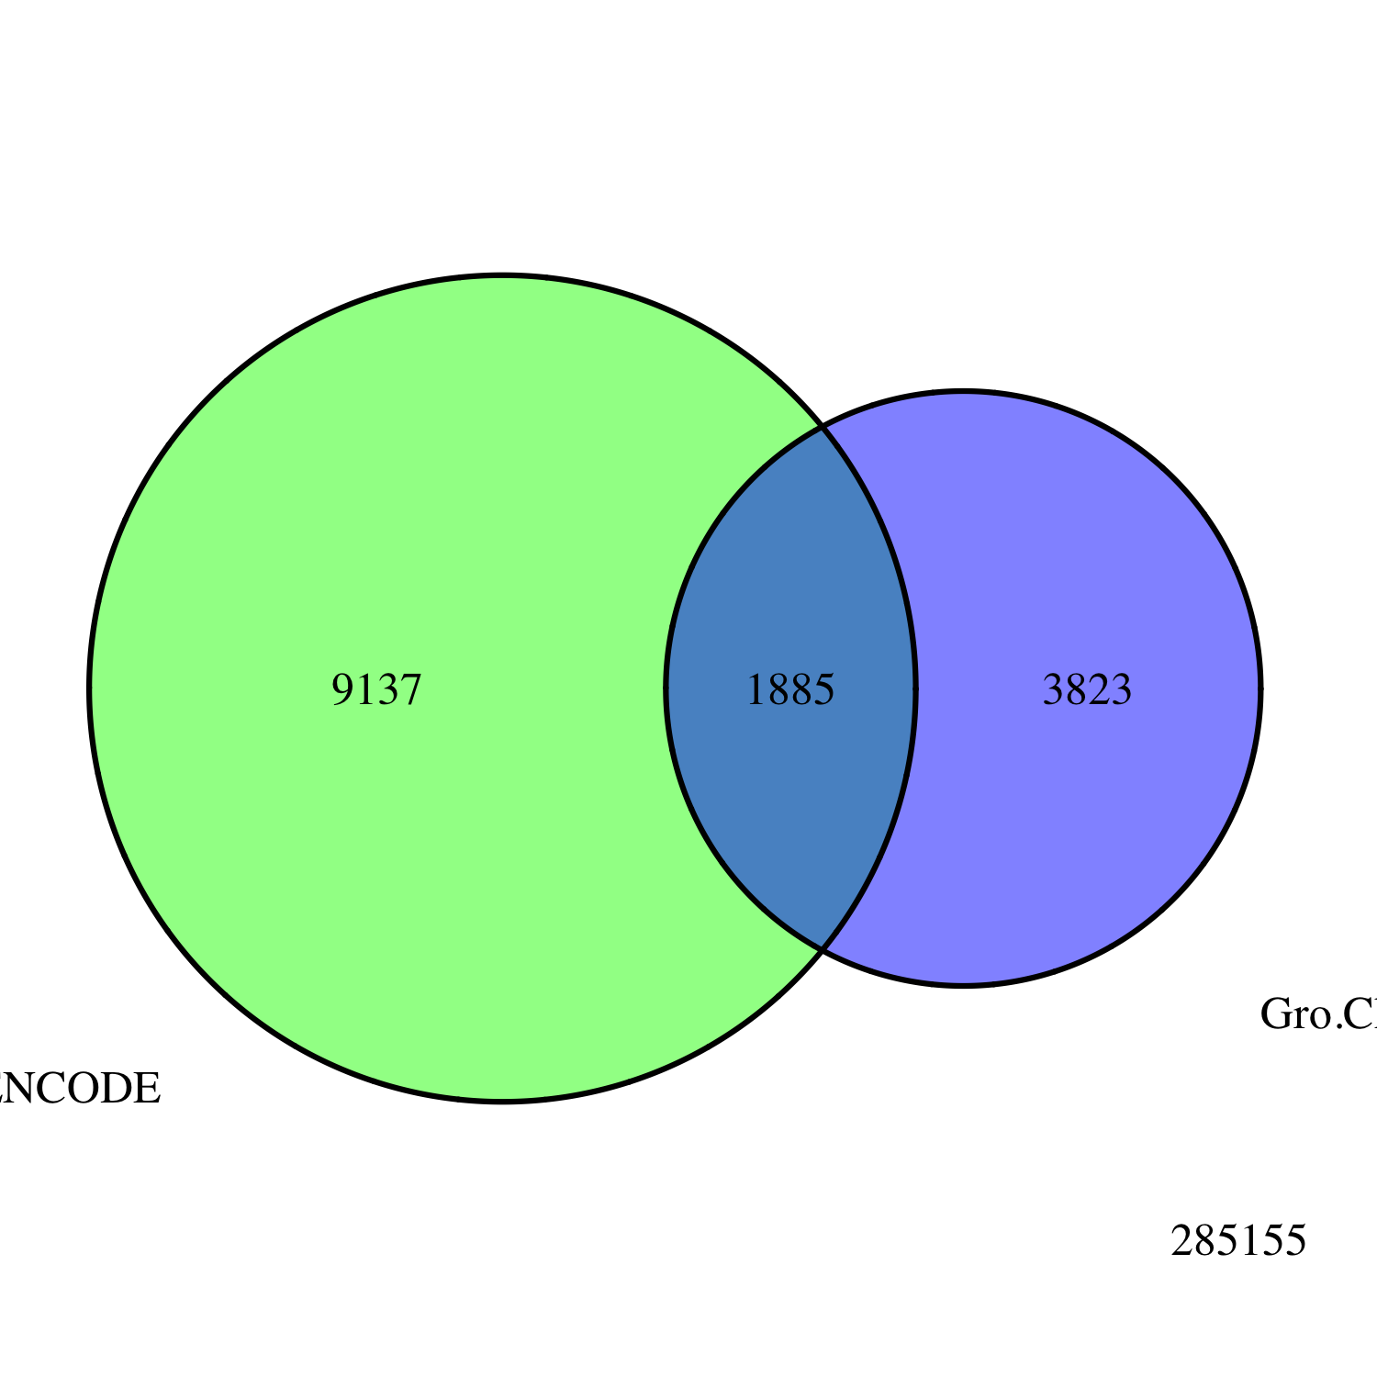
A
Embryo
Gro ChIP-seq
All Peaks
modENCODE
Embryo
Gro ChIP-chip
B
Embryo
Gro ChIP
All Peaks
3823
modENCODE
White Pre-Pupae
Gro ChIP-chip
1885
9137

Slide 3
A
B

Slide 4
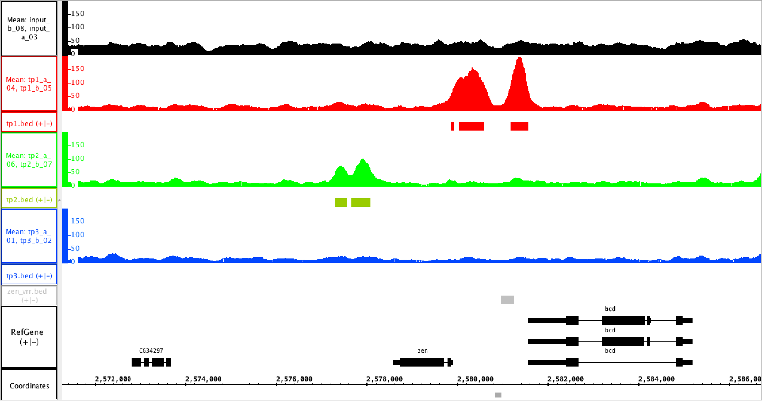
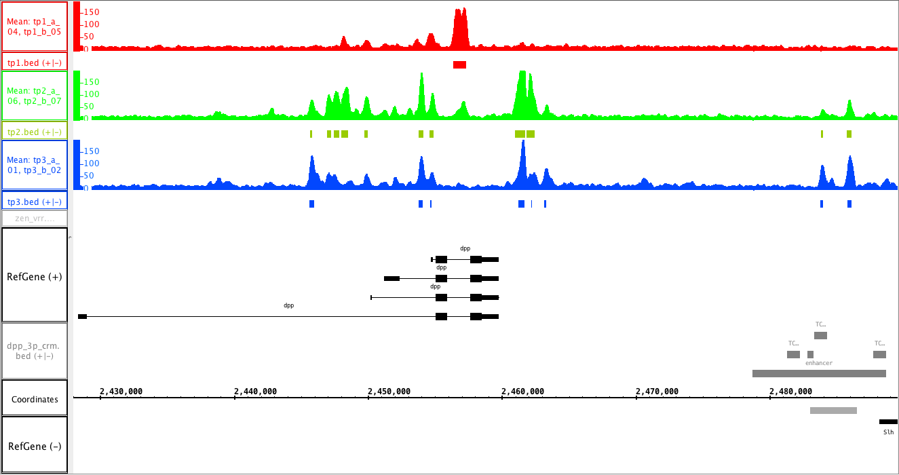
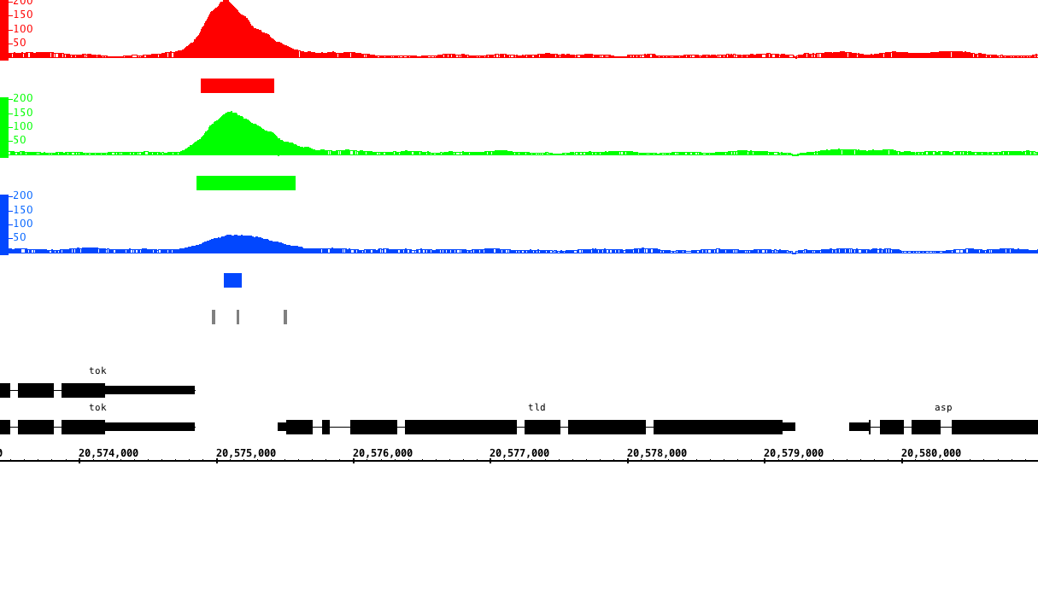
A
1.5 – 4 hr
4 – 6.5 hr
6.5 – 9 hr
VRR
B
1.5 – 4 hr
4 – 6.5 hr
6.5 – 9 hr
C
1.5 – 4 hr
4 – 6.5 hr
6.5 – 9 hr
Dorsal binding sites

Slide 5
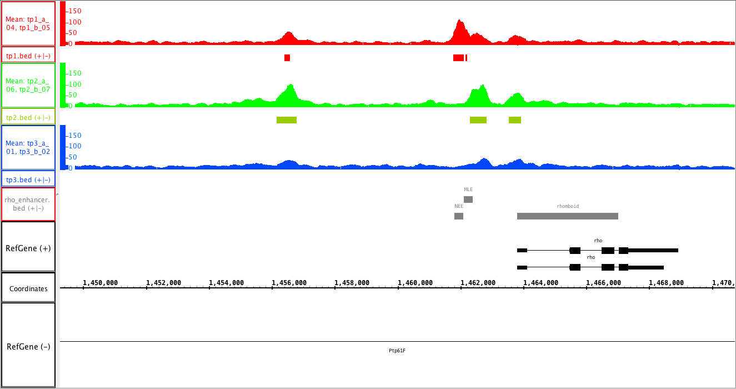
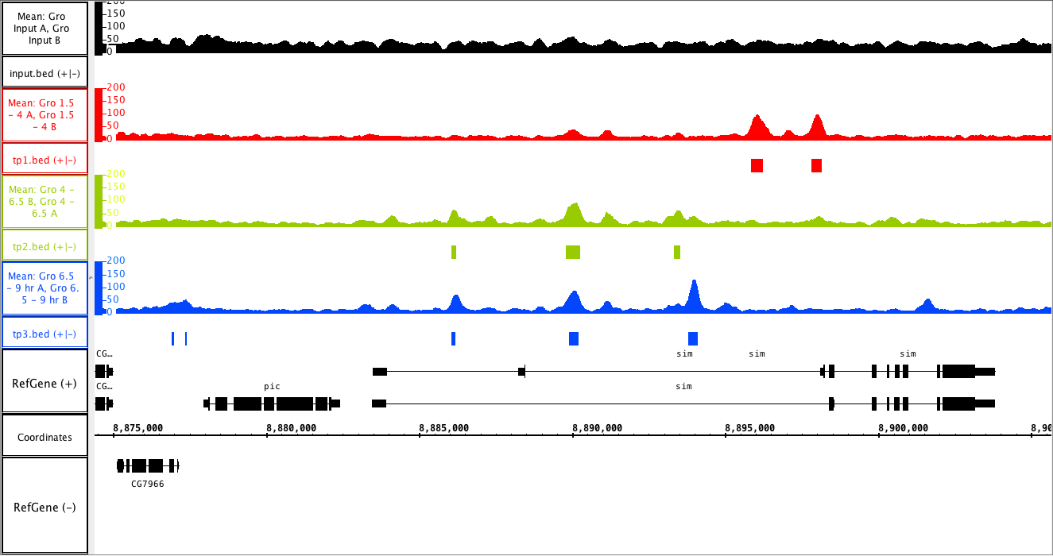
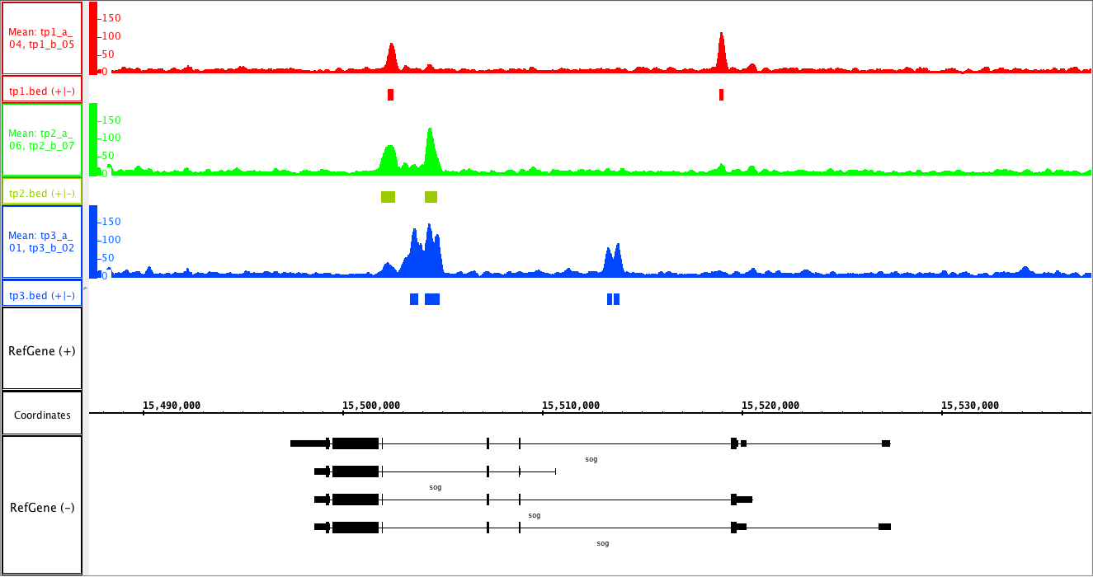
A
1.5 – 4 hr
4 – 6.5 hr
6.5 – 9 hr
NEE
MLE
B
1.5 – 4 hr
4 – 6.5 hr
6.5 – 9 hr
C
1.5 – 4 hr
4 – 6.5 hr
6.5 – 9 hr

Slide 6
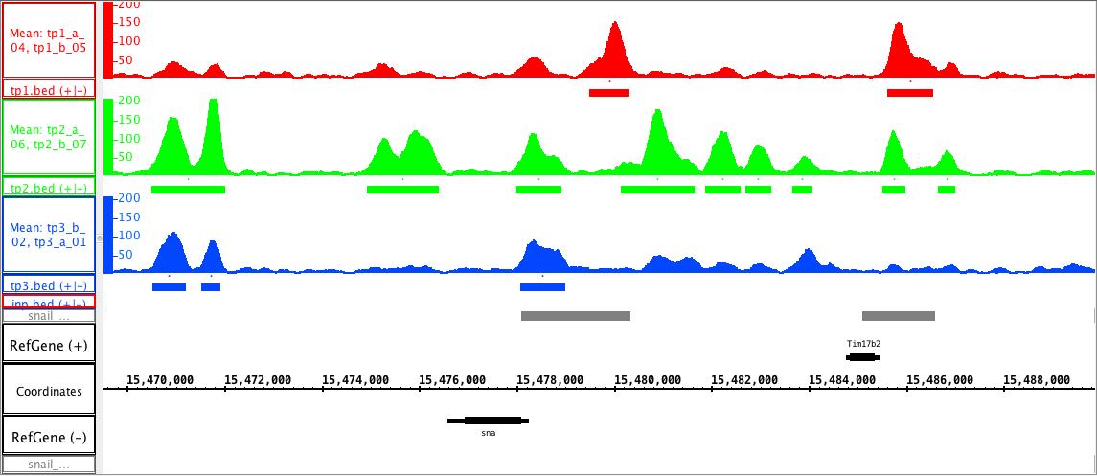
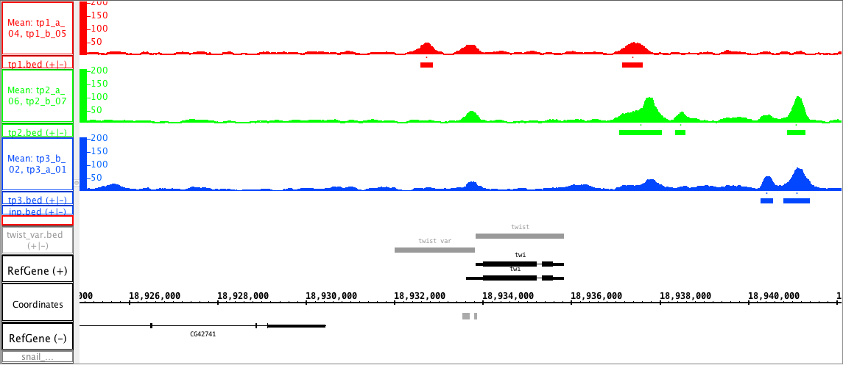
A
1.5 – 4 hr
4 – 6.5 hr
6.5 – 9 hr
primary
shadow
B
1.5 – 4 hr
4 – 6.5 hr
6.5 – 9 hr
VAR

Slide 7
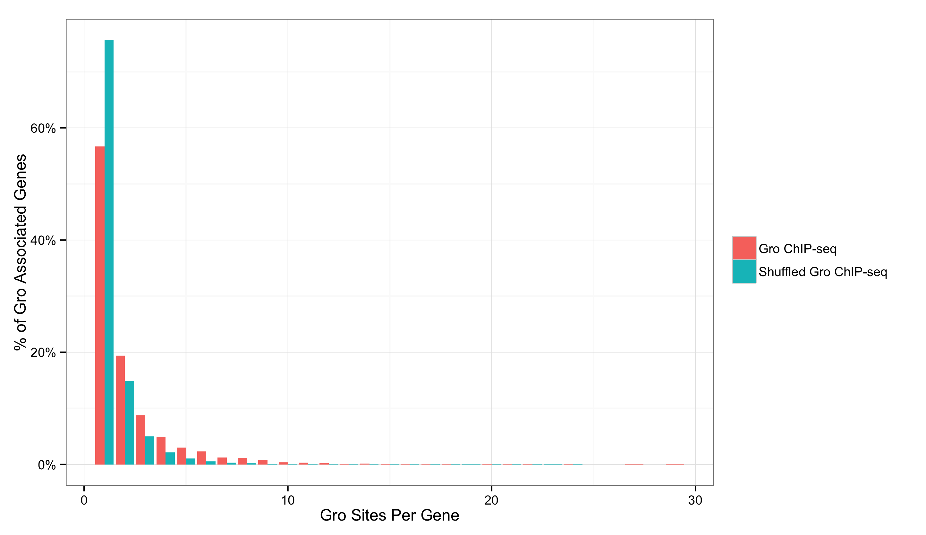
A
B
1
2
3
4
5

Slide 8
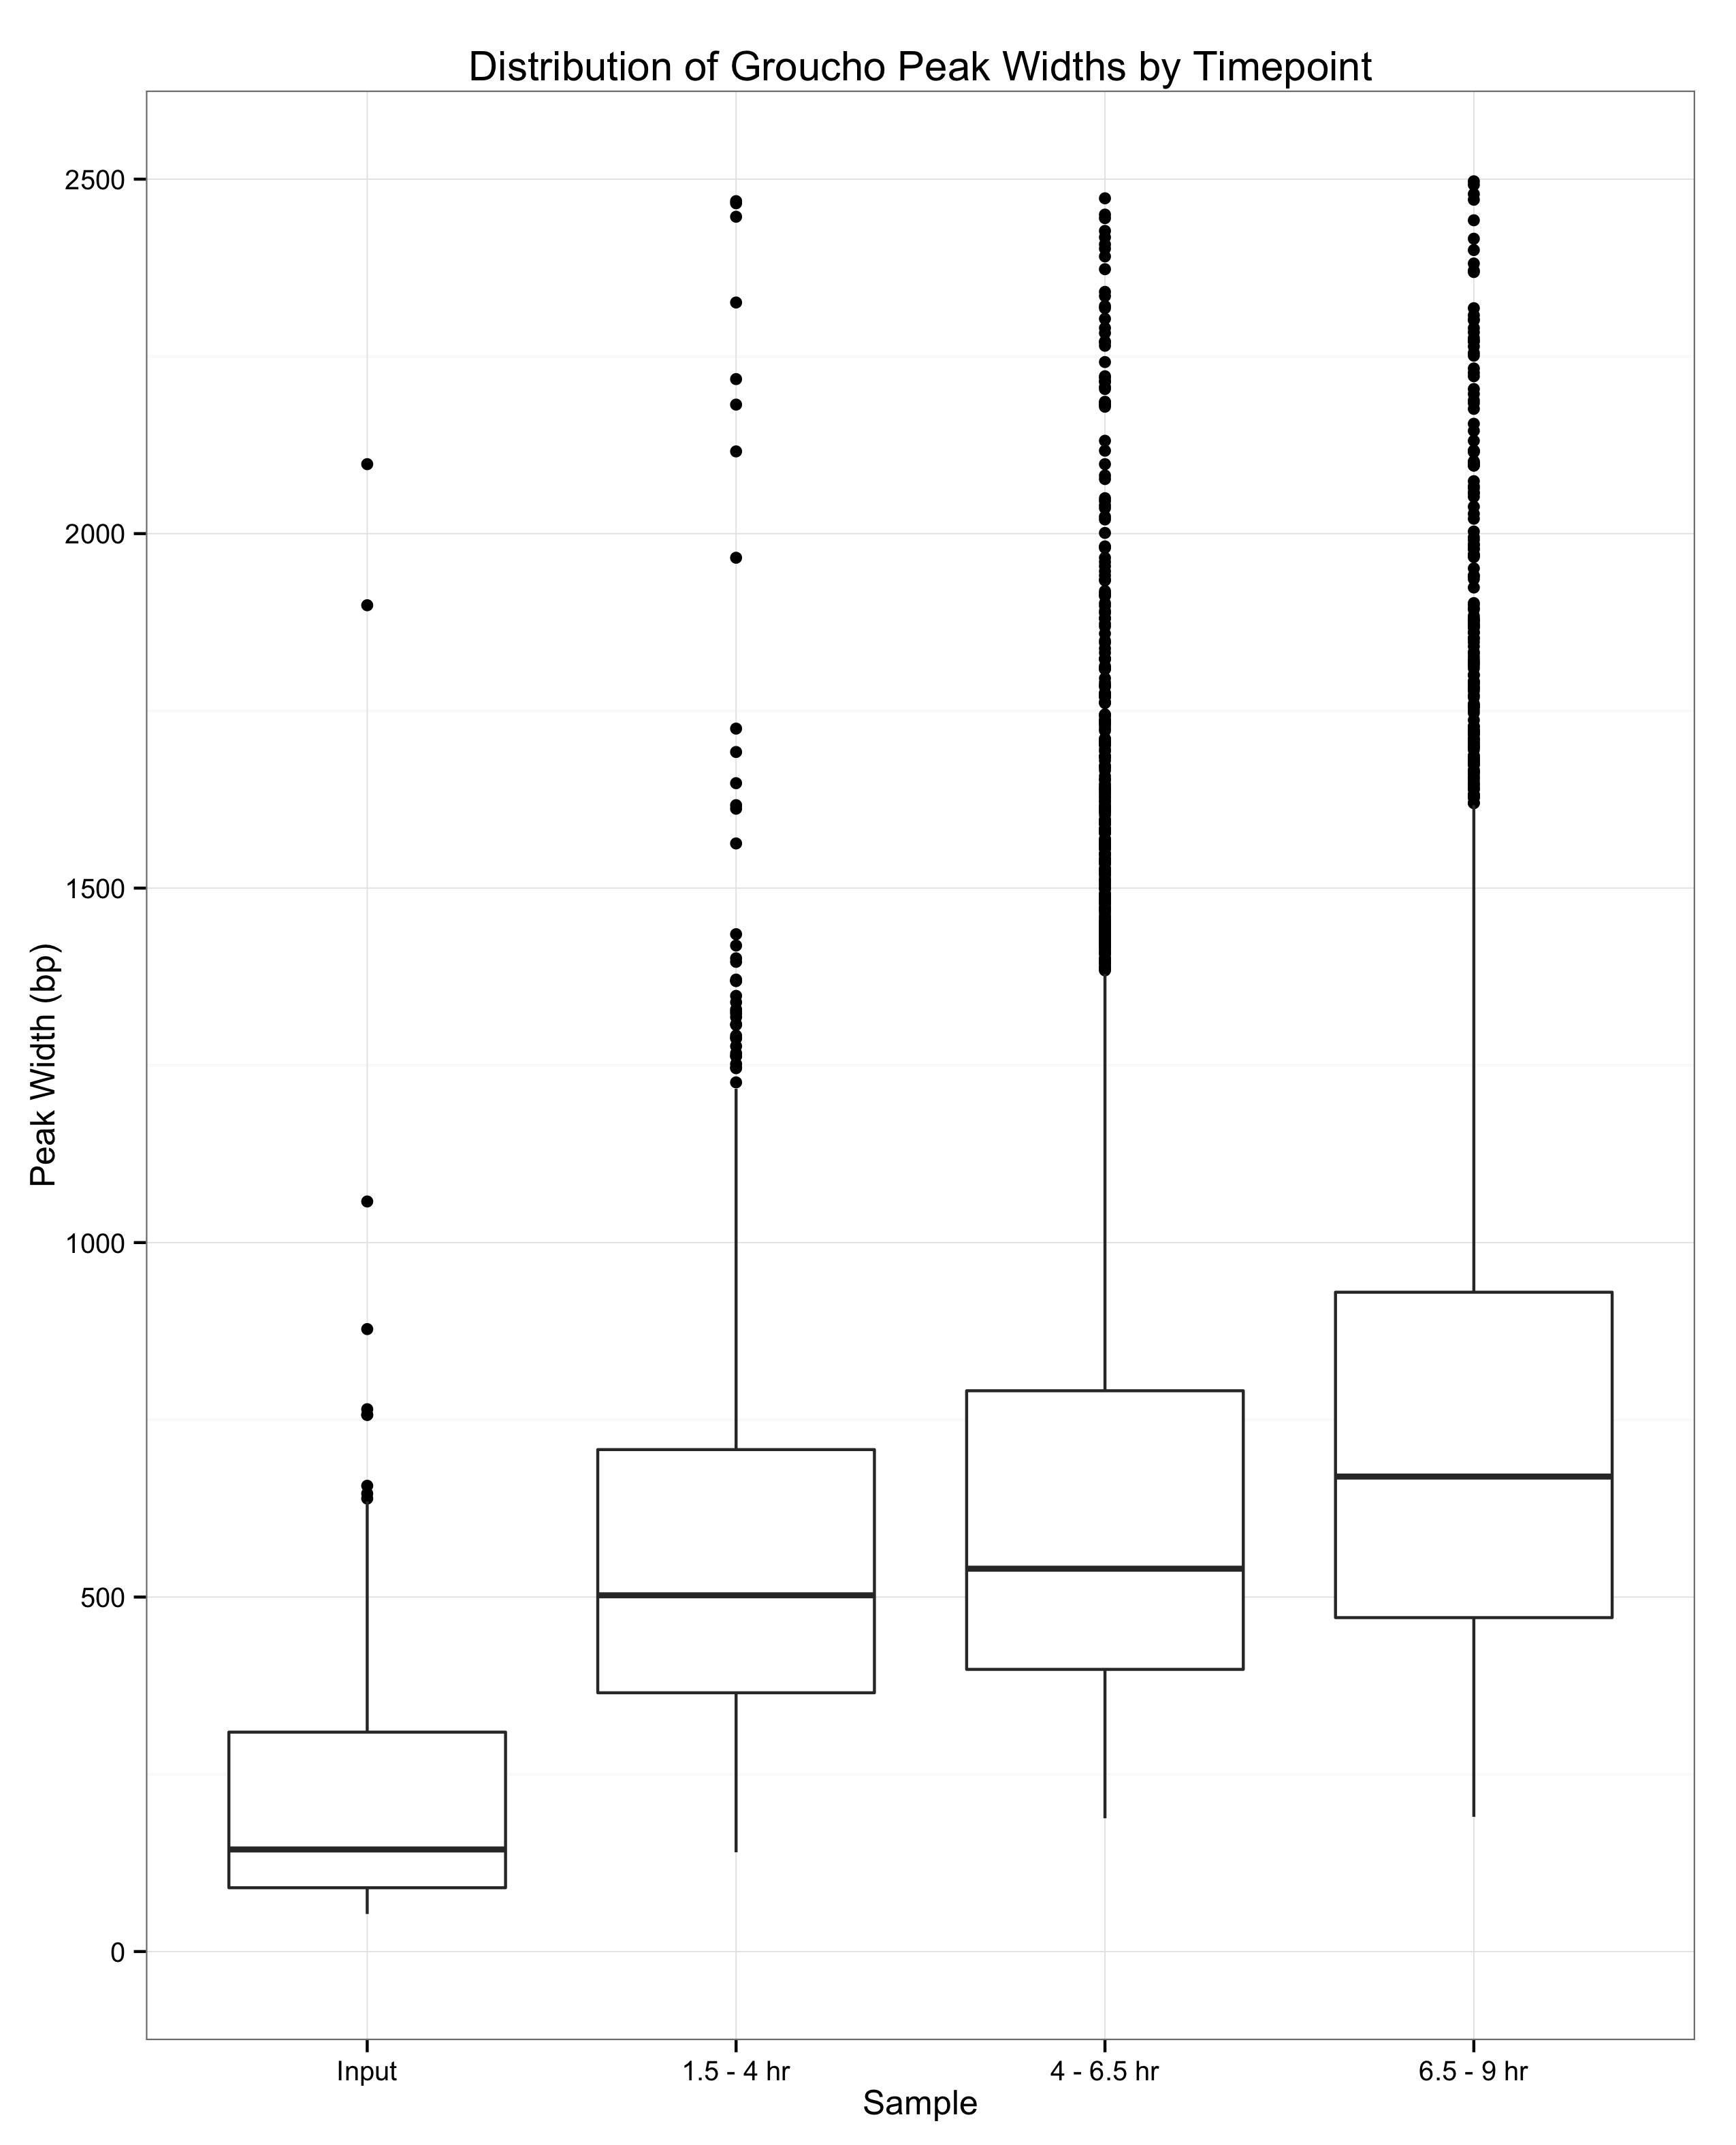

Slide 9
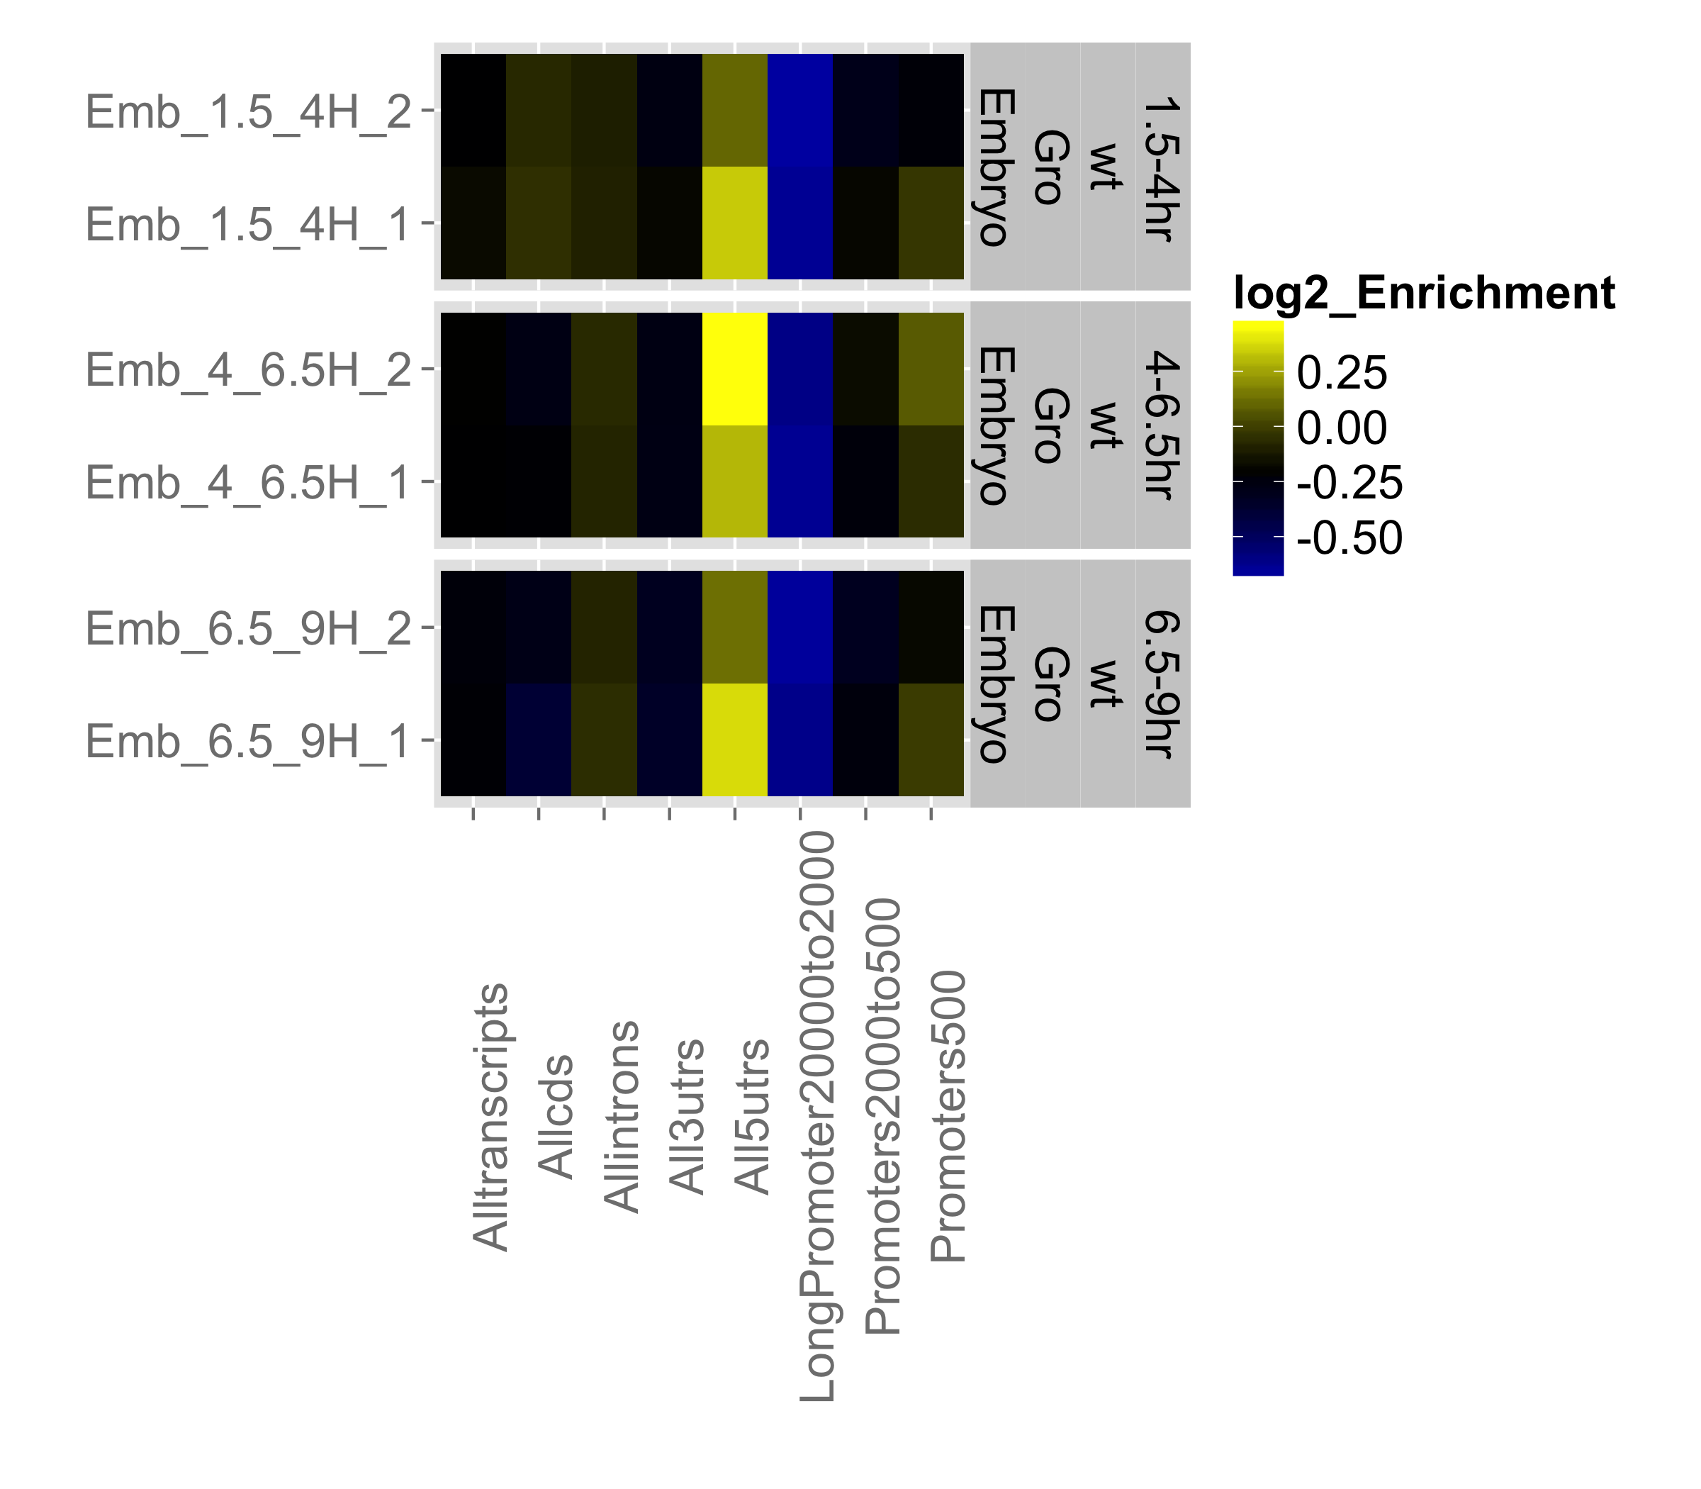
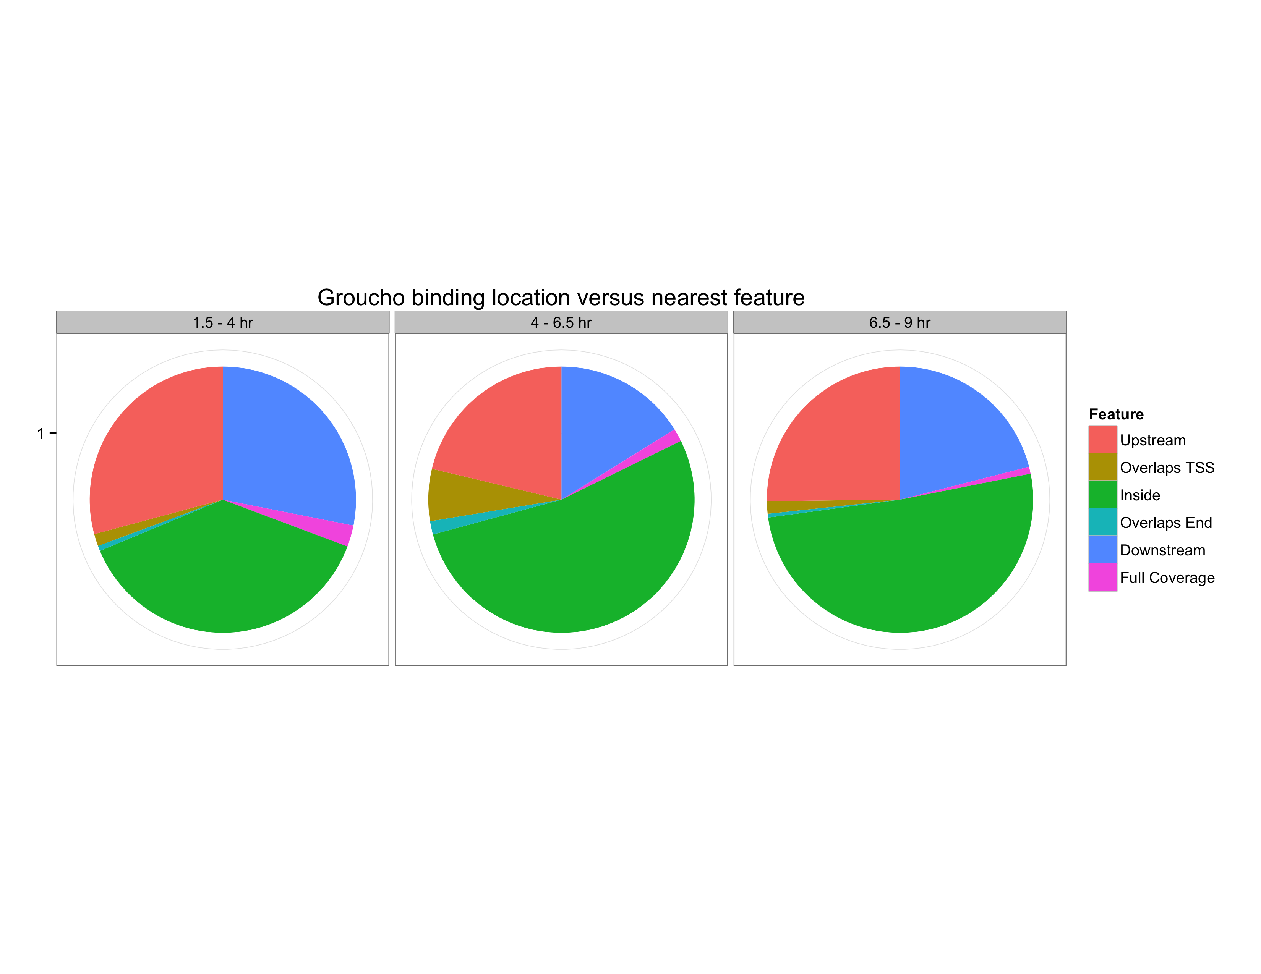
A
Upstream
(bp)
500 to -50
2,000 to 500
20,000 to 2,000
5’ UTR
3’ UTR
Intron
CDS
Transcript
B

Slide 10
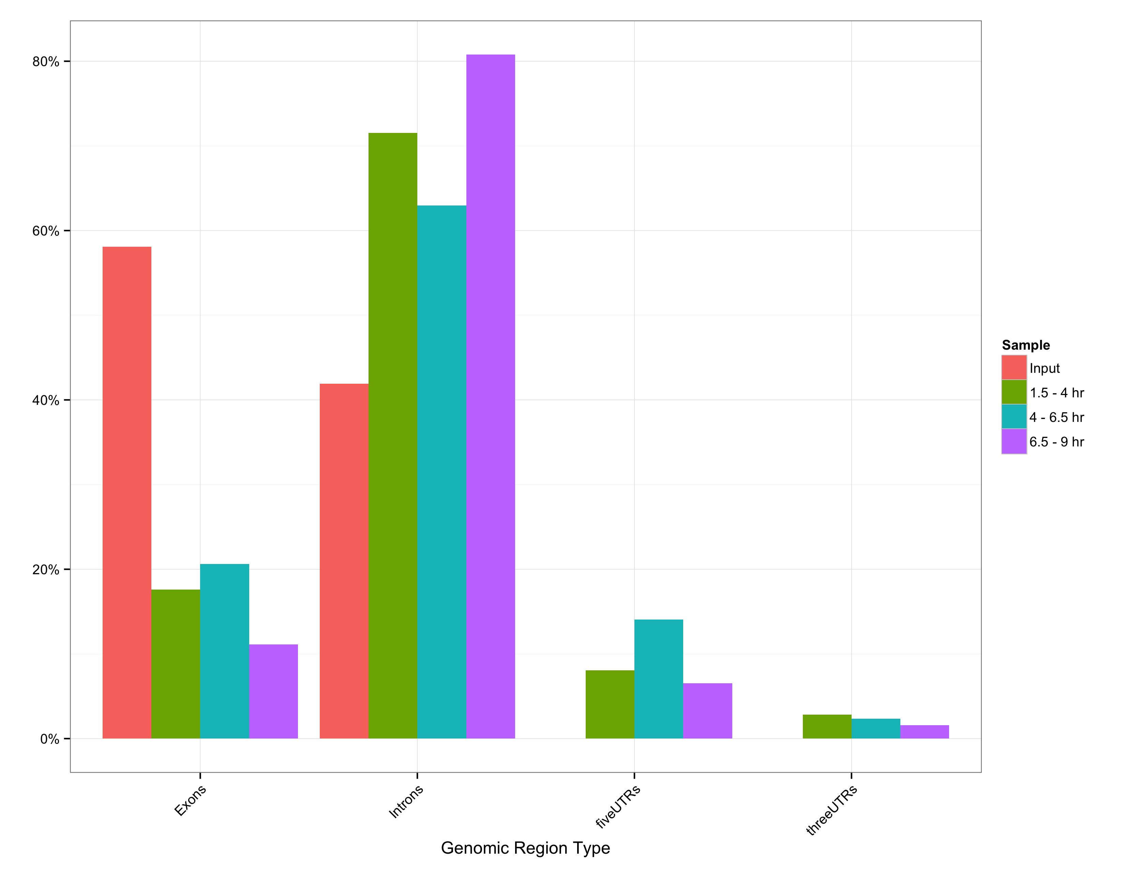
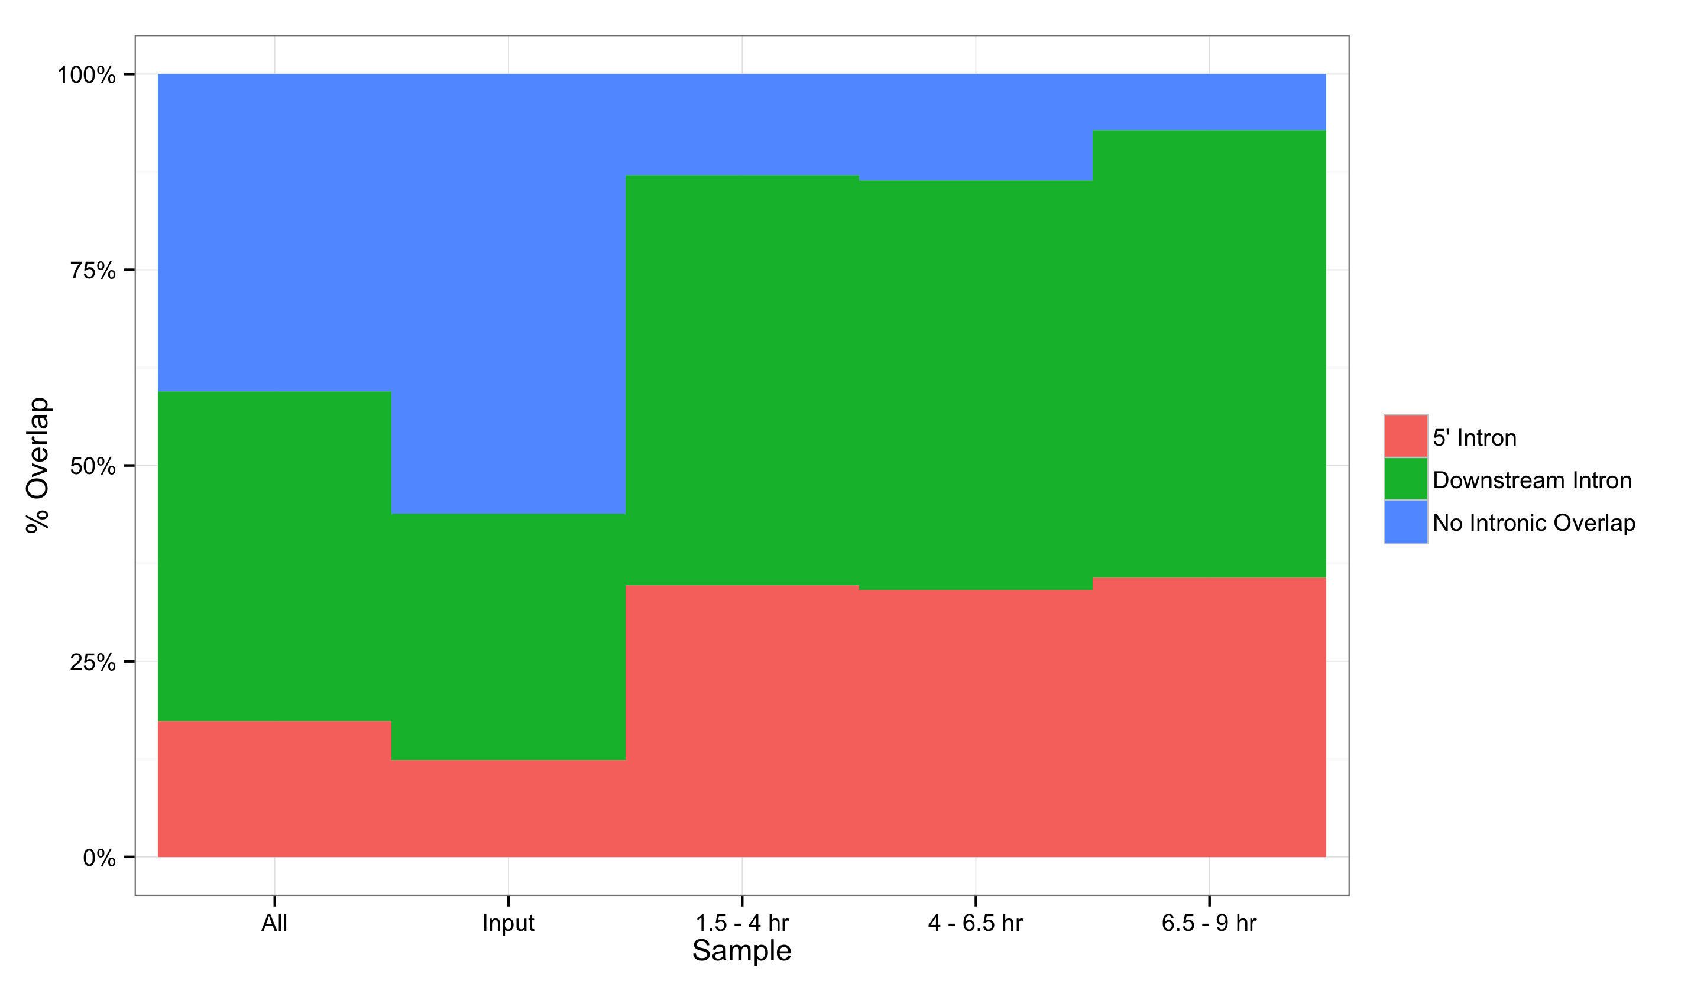
A
B

Slide 11
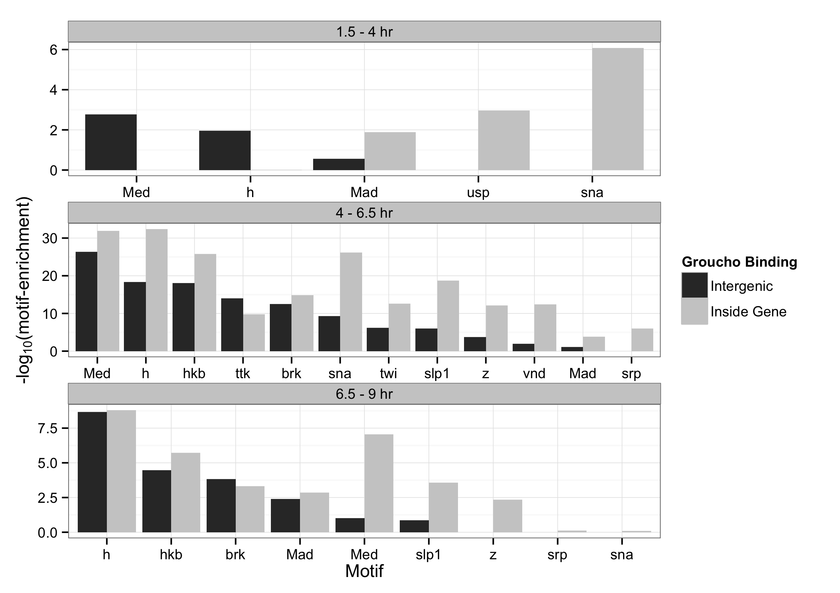

Slide 12
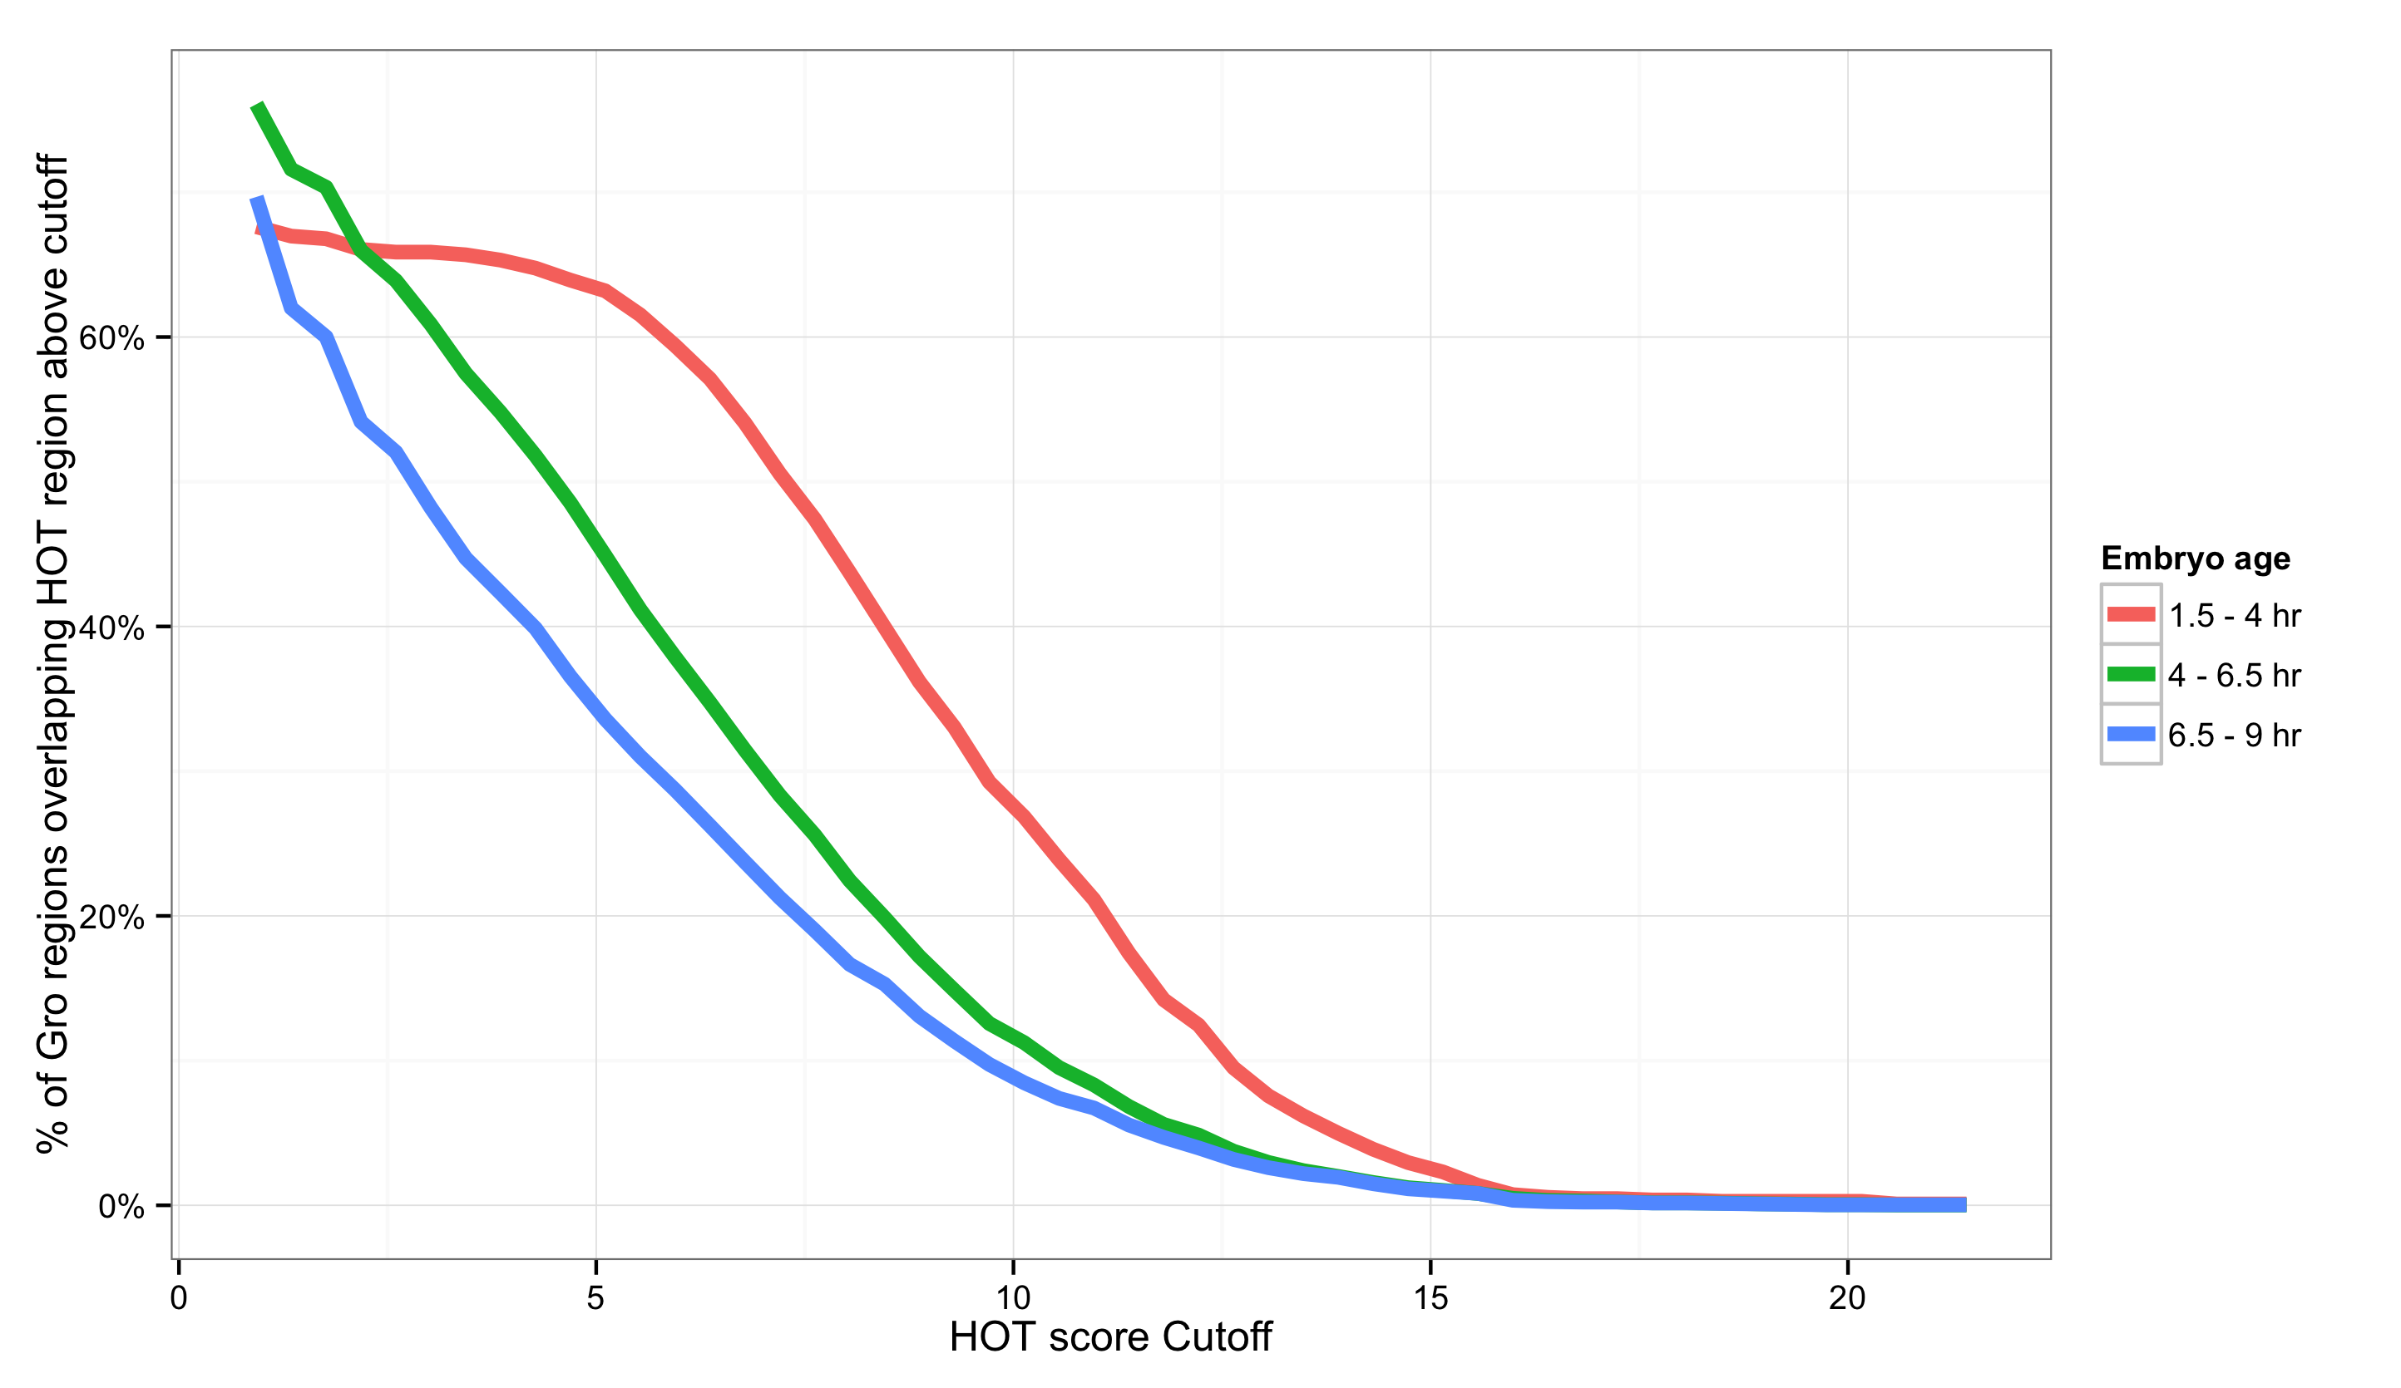
<
<
<
<

Slide 13
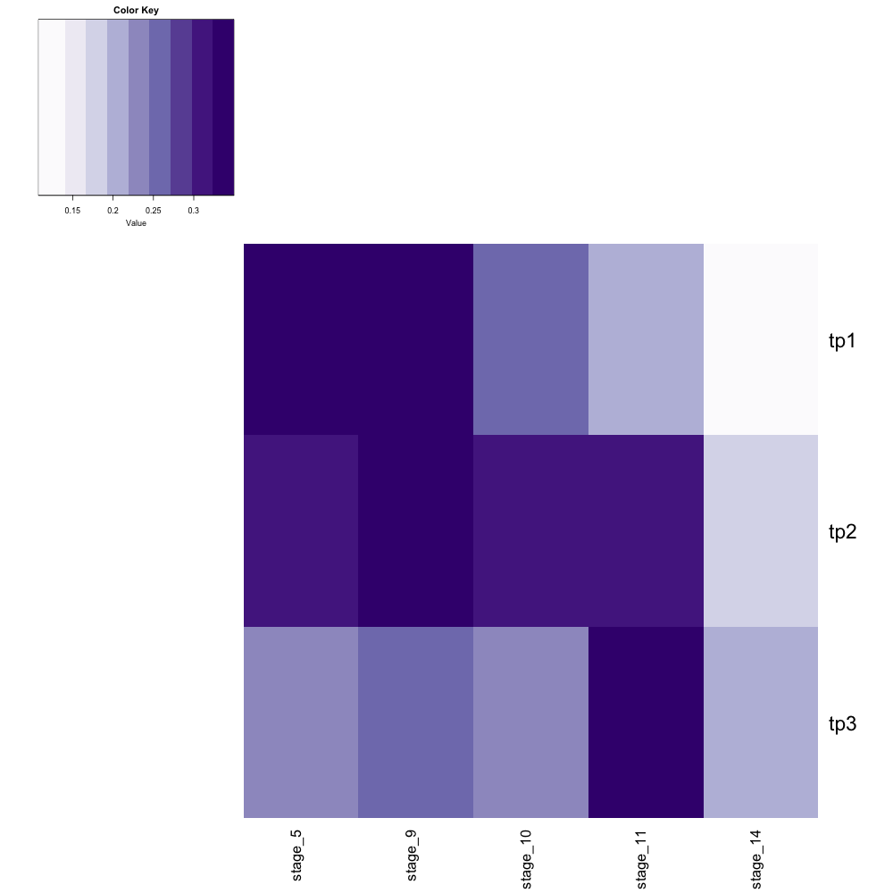

30%
25%
20%
15%
Chromatin accessibility (DNase-seq)
Stage 5
Stage 9
Stage 10
Stage 11
Stage 14
1.5 – 4 hr
Groucho ChIP-seq
4 – 6.5 hr
6.5 – 9 hr
1.5 – 4 hr
4 – 6.5 hr
6.5 – 9 hr

Slide 14
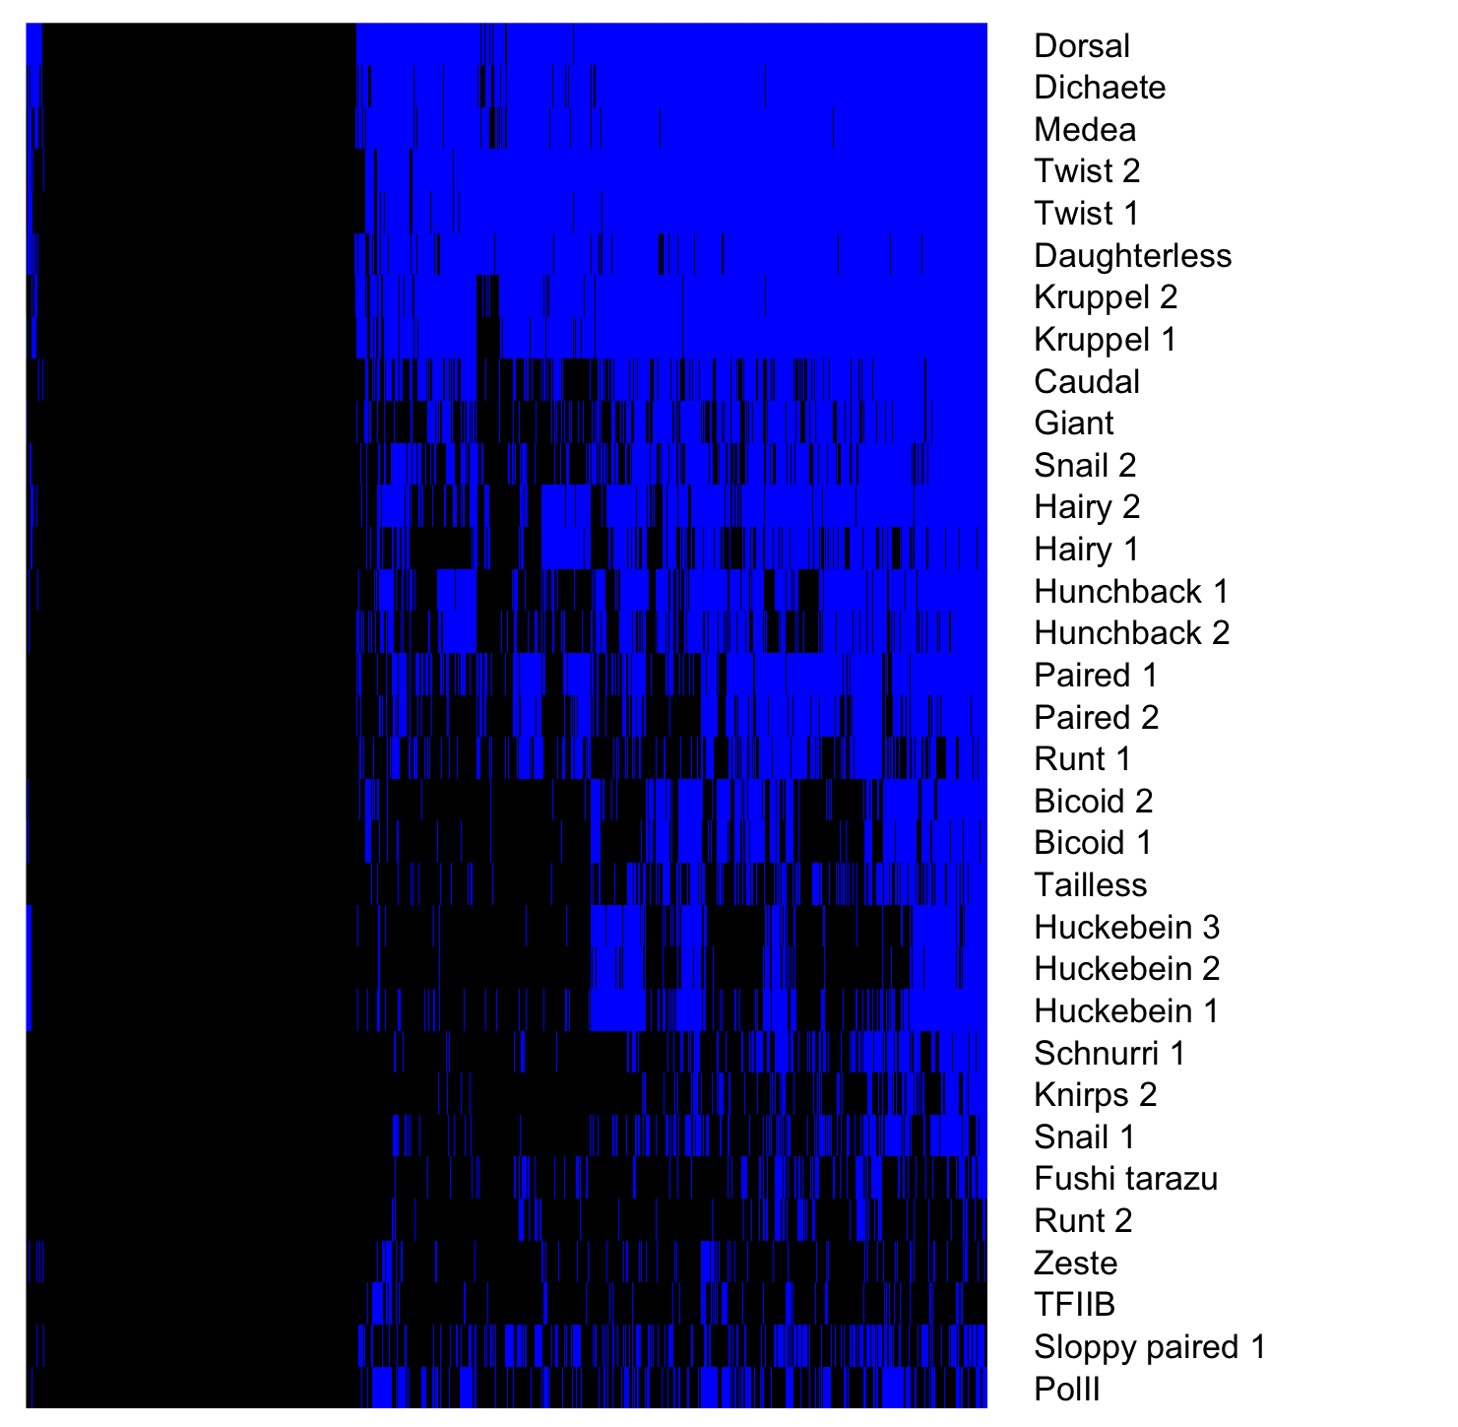
Gro binding sites, 1.5 – 4 hr embryos
Factor occupancy

Slide 15
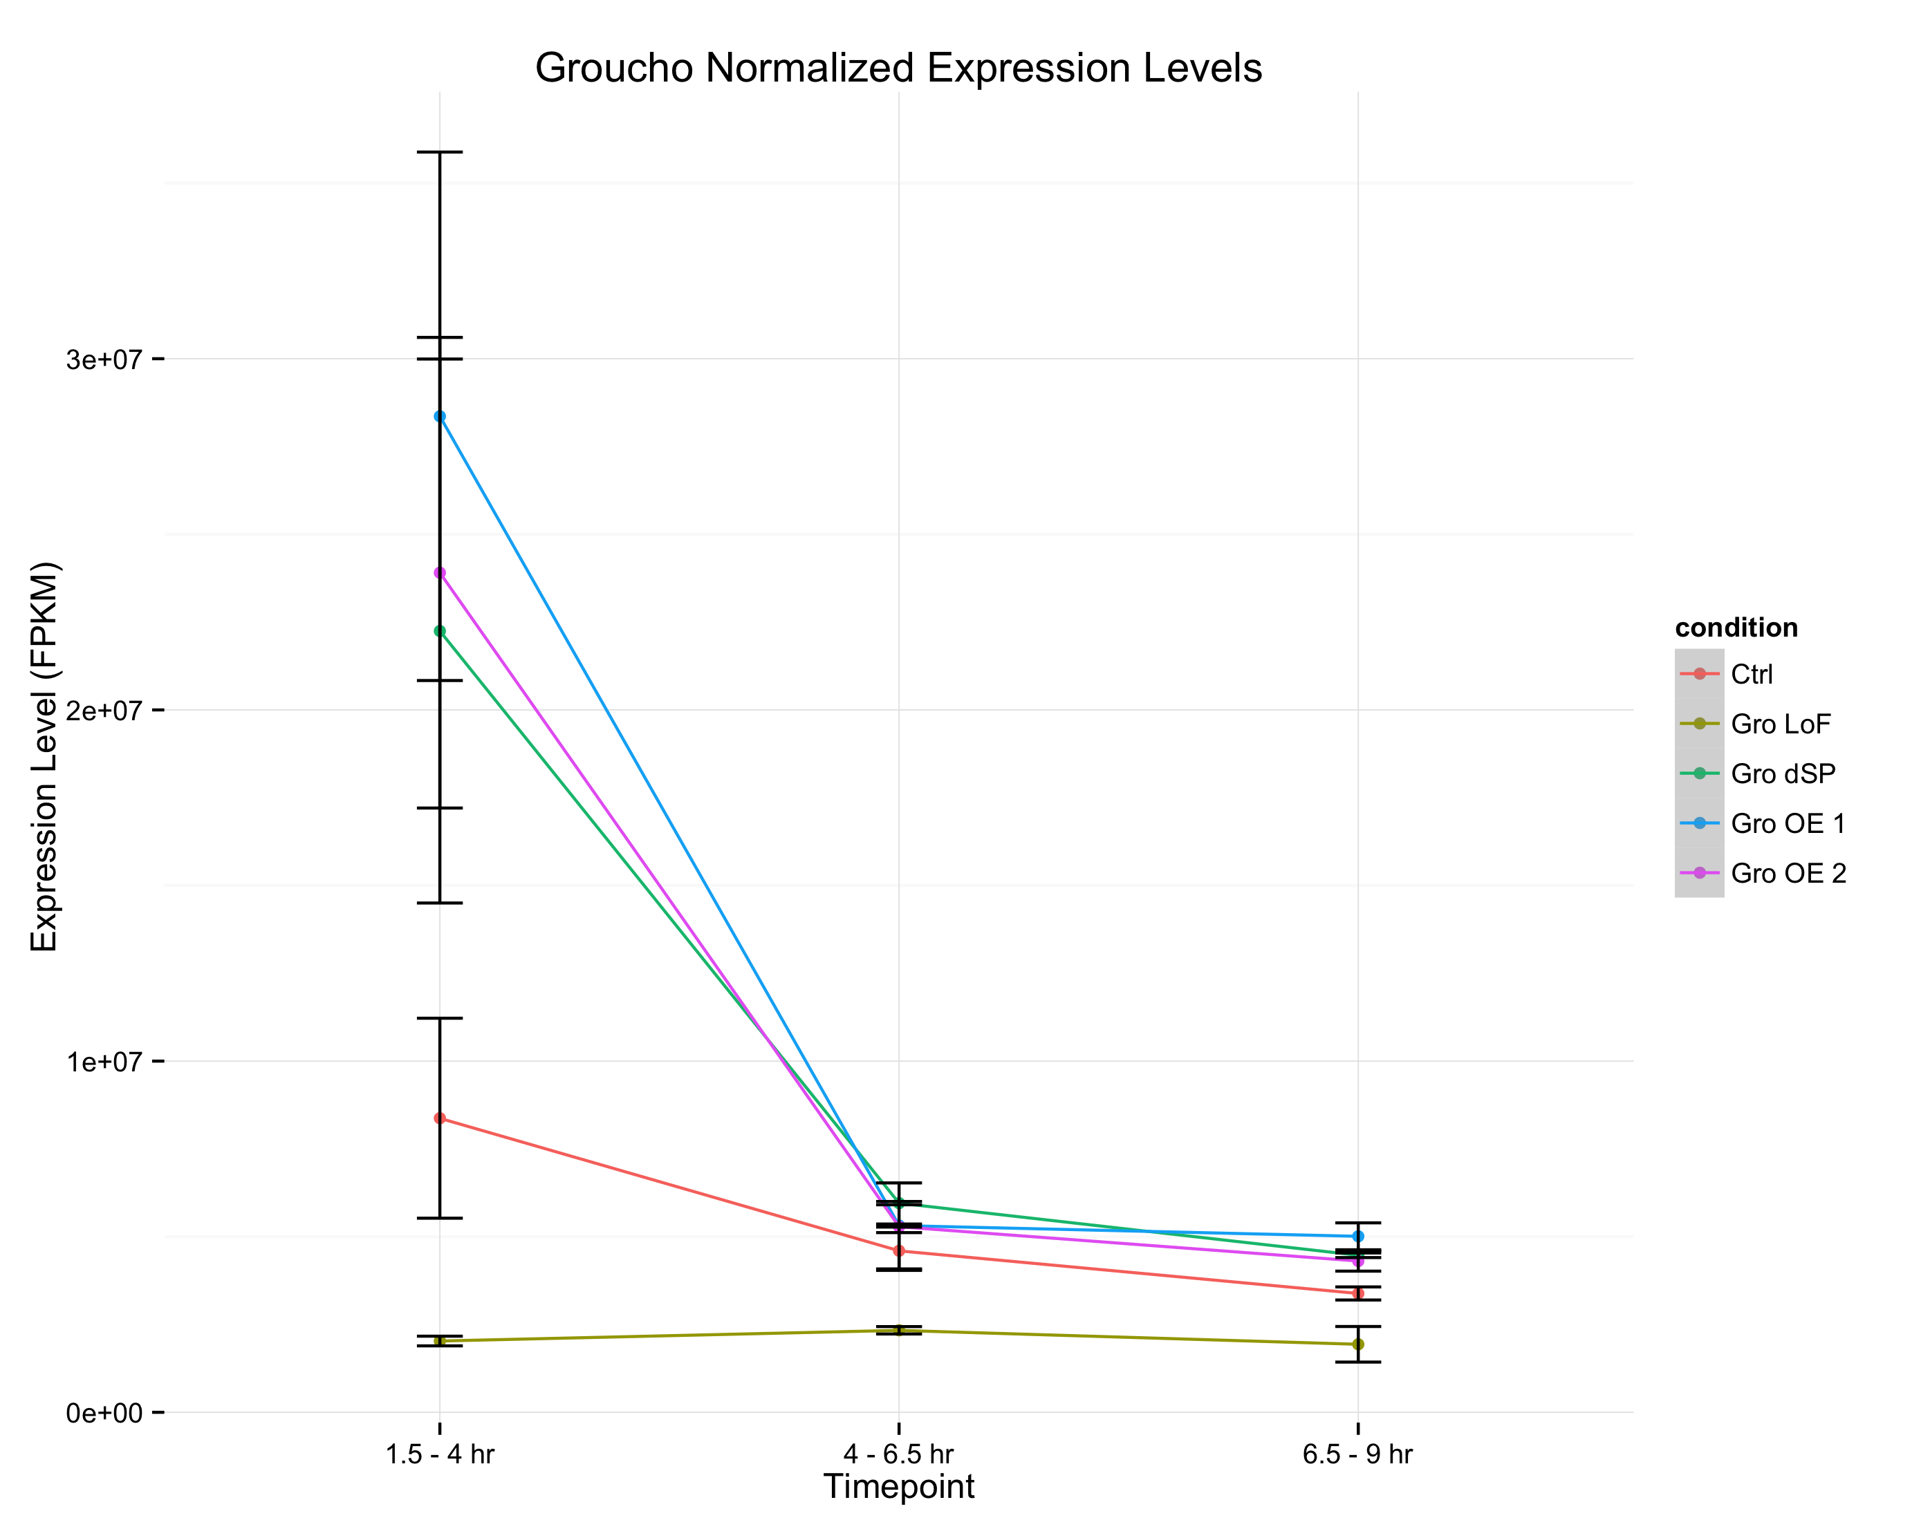
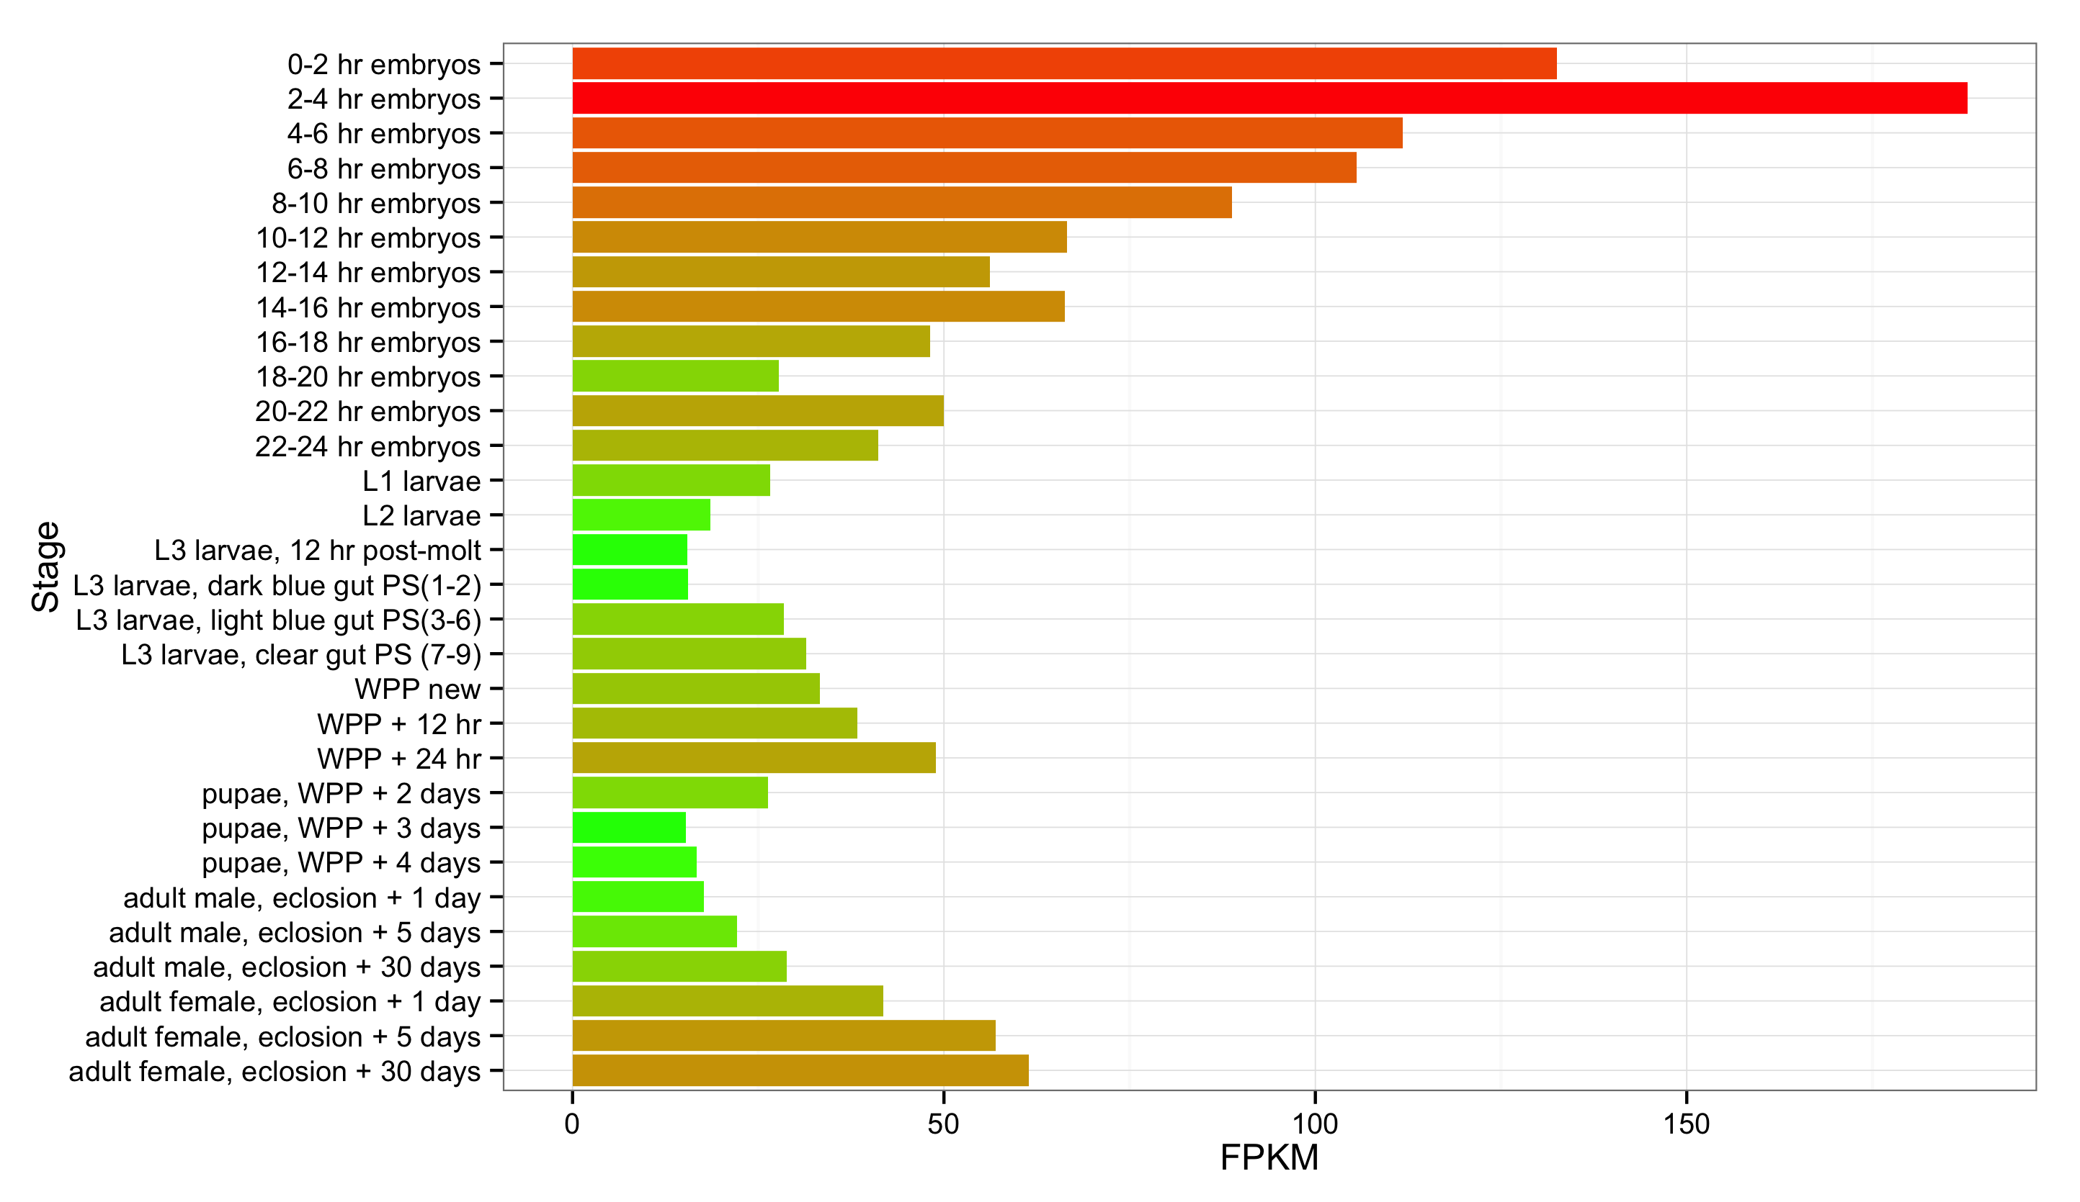
A
wt
Gro^{MB36}
GroΔSP
Gro overexpression 1
Gro Overexpression 2
Groucho transcript abundance
modENCODE Developmental Transcriptome Project
B

Slide 16
Key

Slide 17
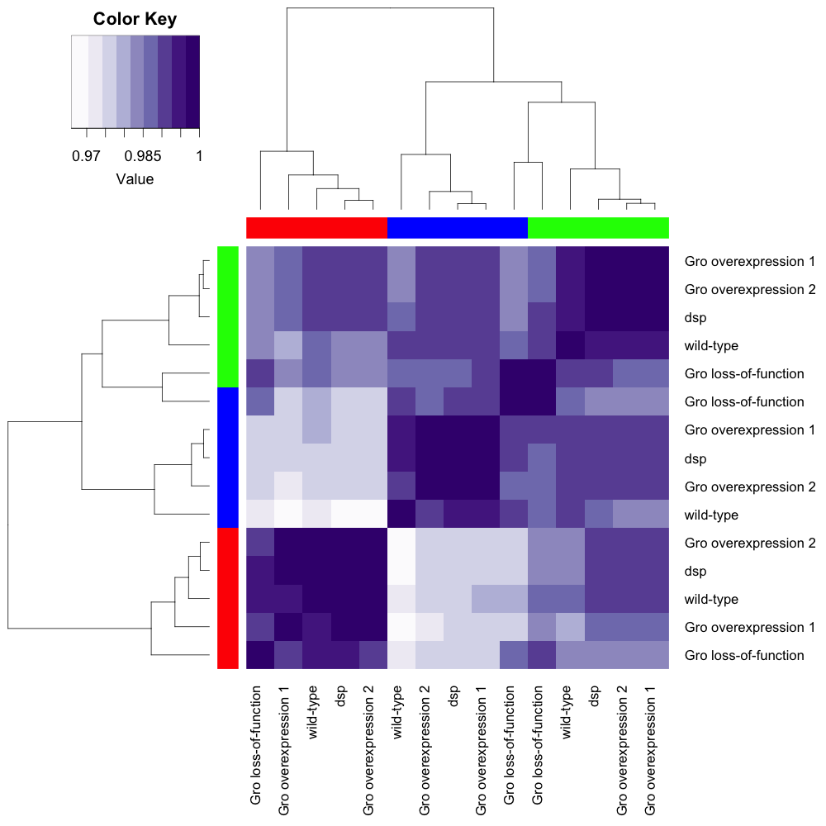
-
- 1
Spearman
coefficient
- 0.9
1.5 – 4 hr
4 – 6.5
6.5 – 9
GroΔSP
GroΔSP
GroΔSP
GroΔSP
GroΔSP
GroΔSP

Slide 18
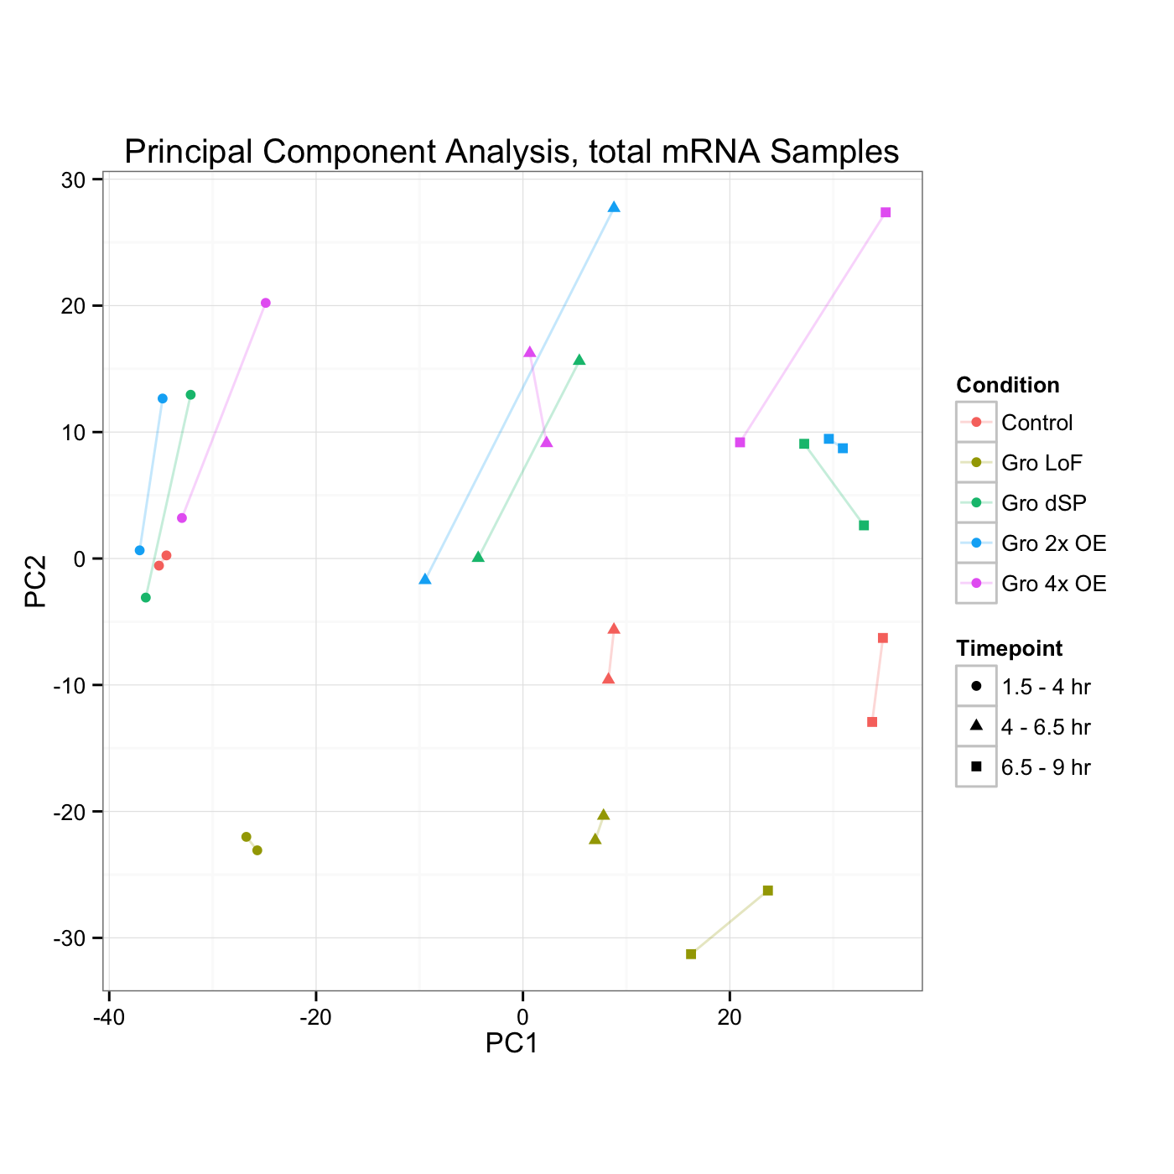
Gro Dosage
Developmental Stage

Slide 19
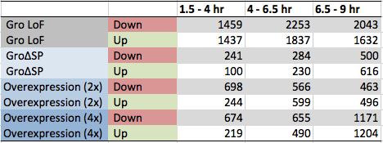
A
B

Slide 20
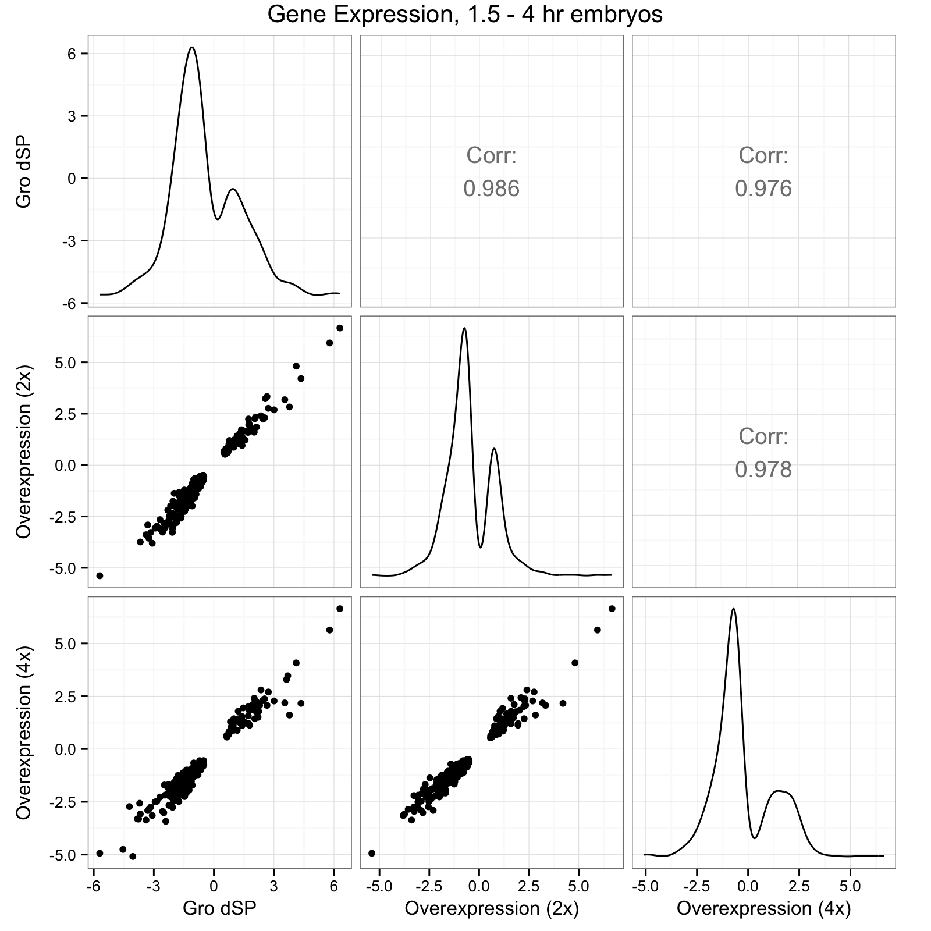
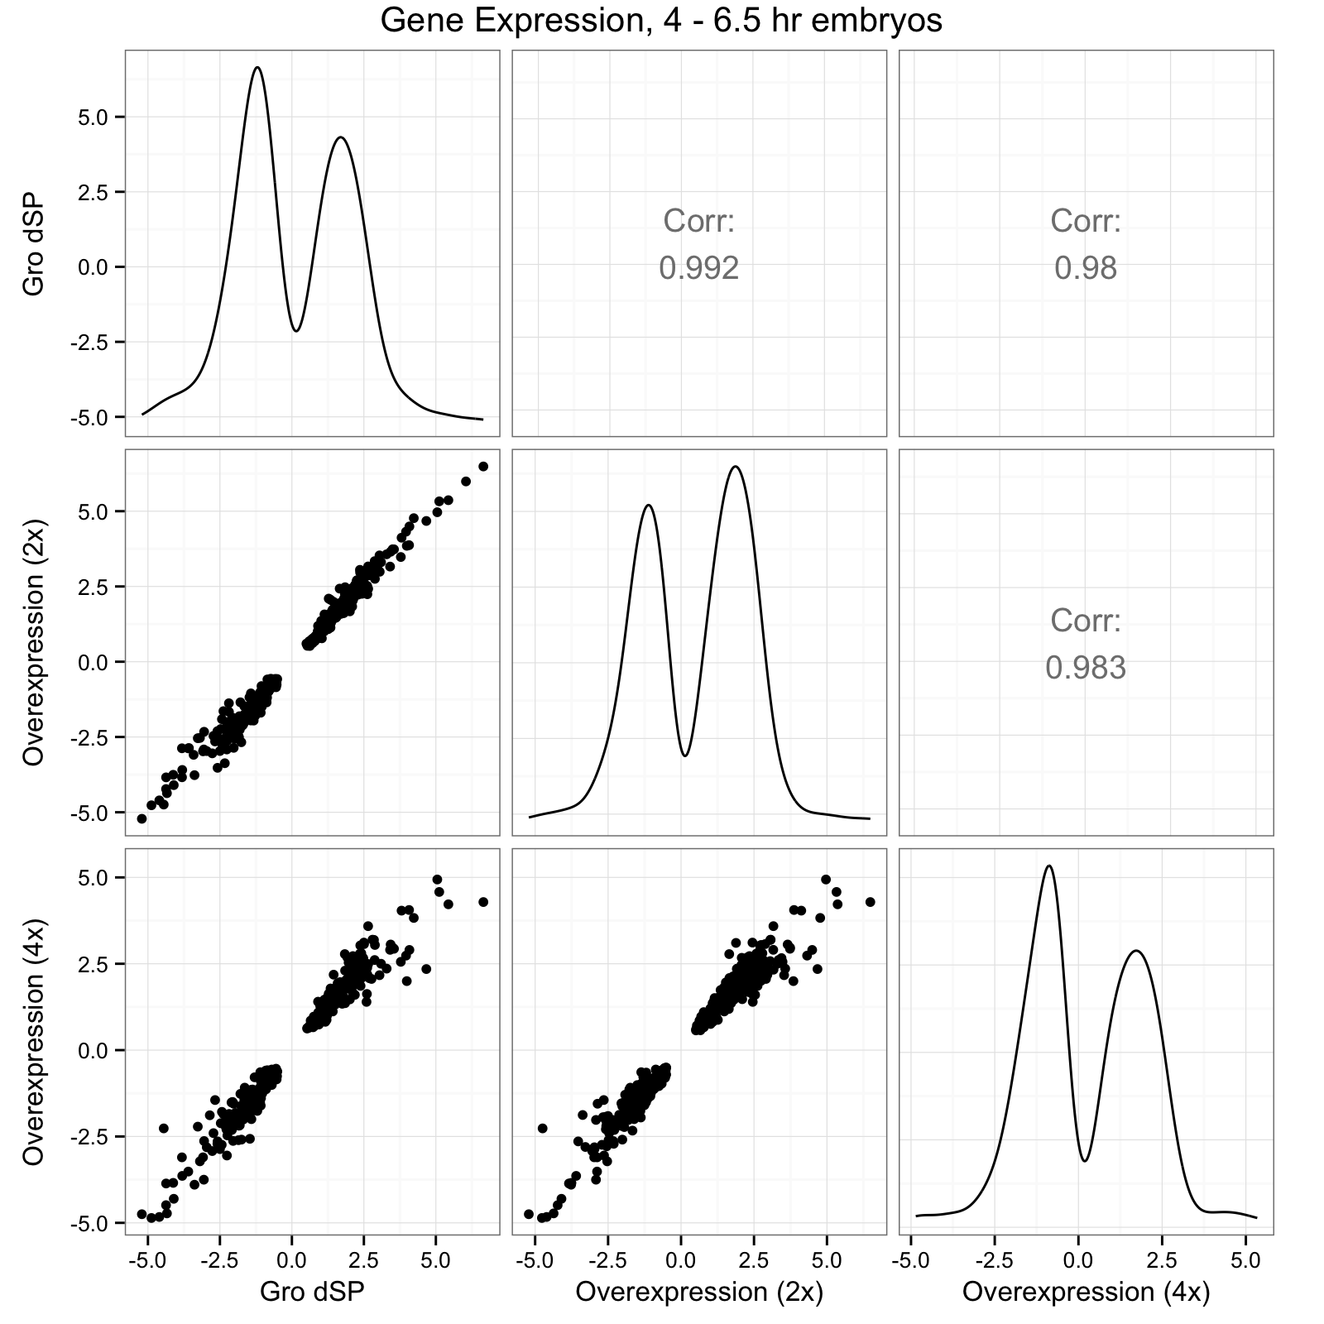
A
B

Slide 21
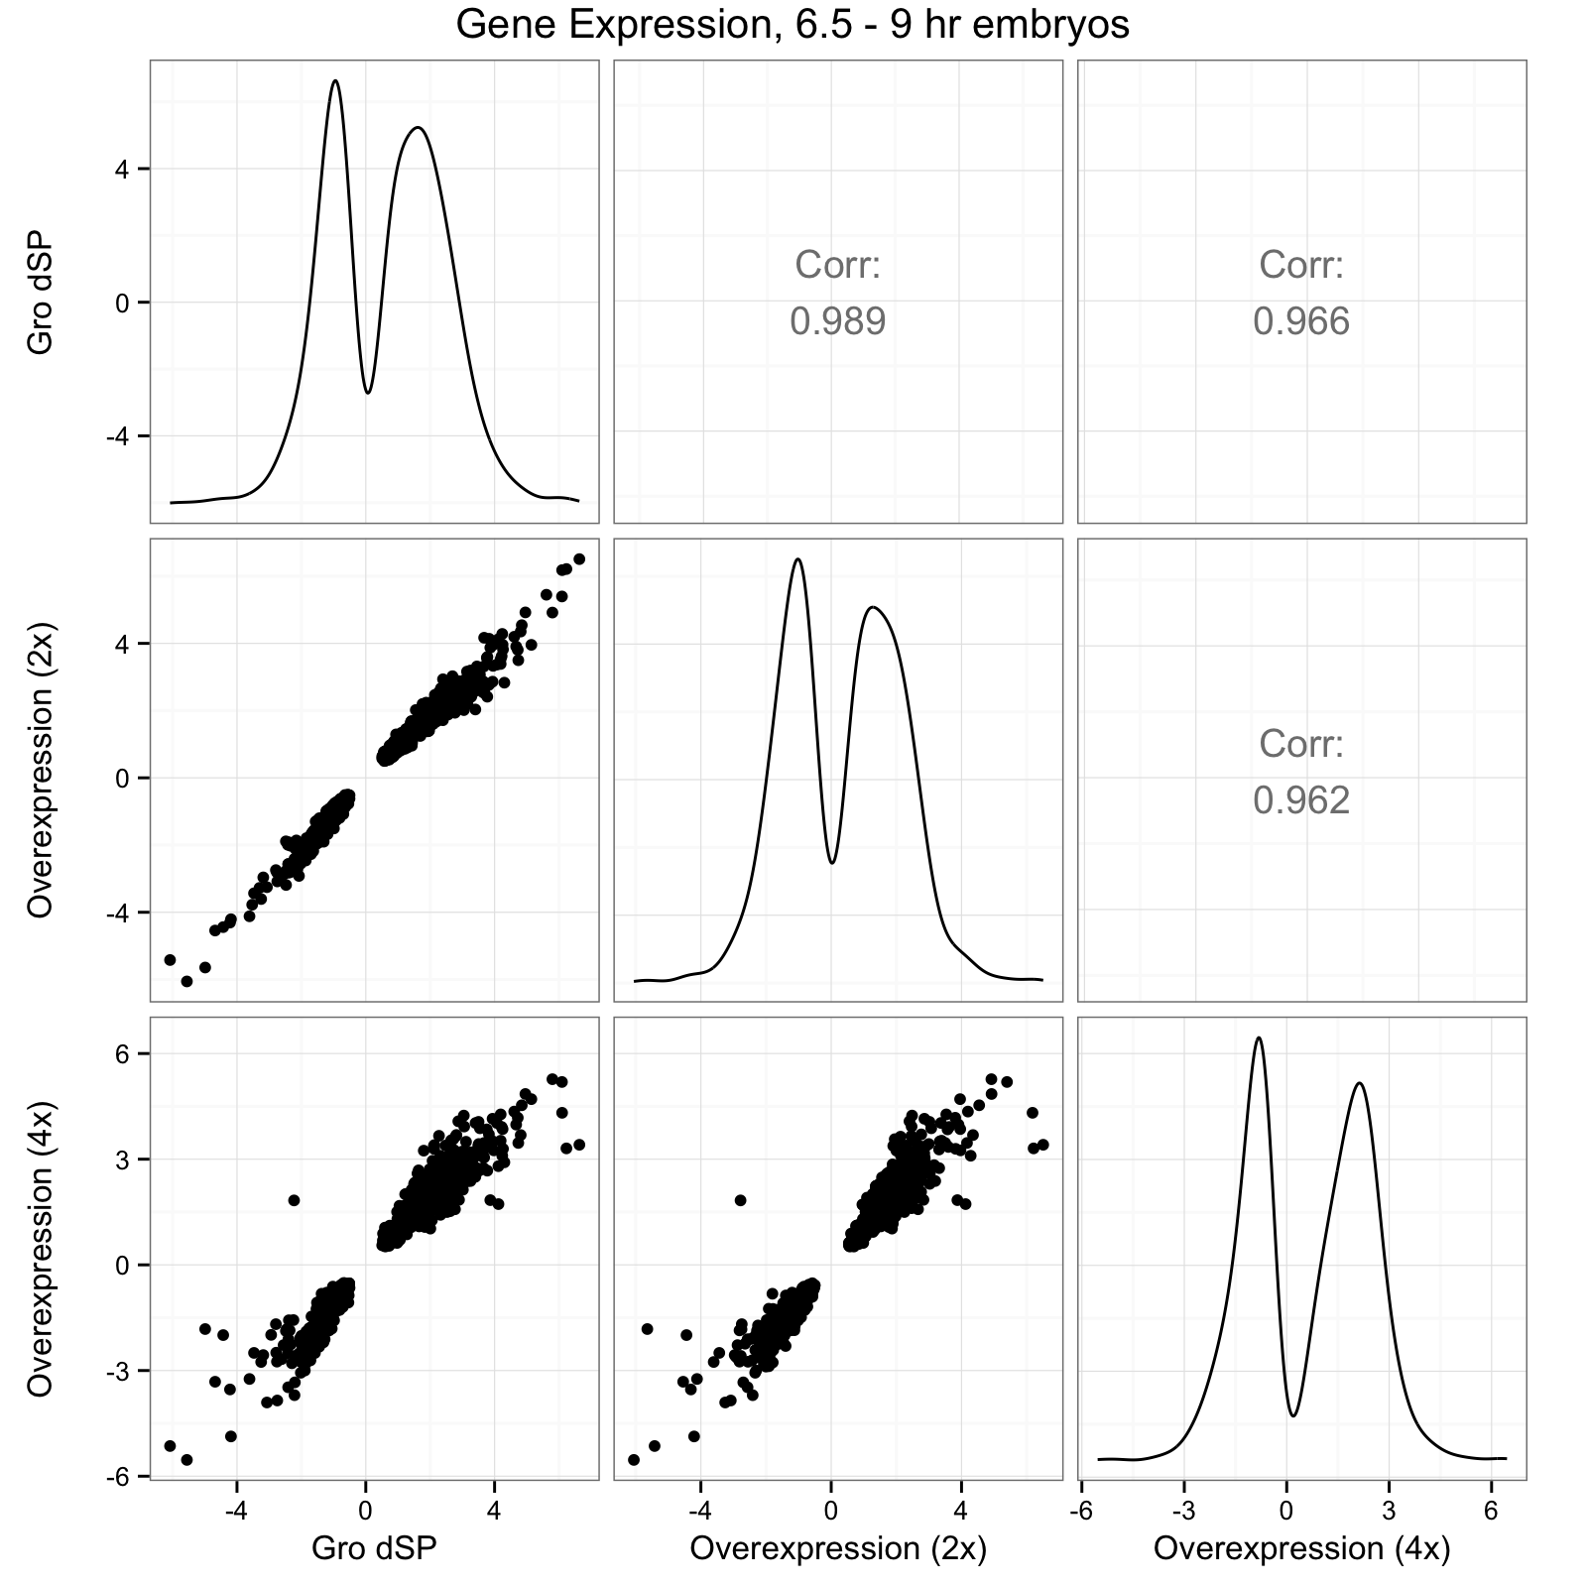
C

Slide 22
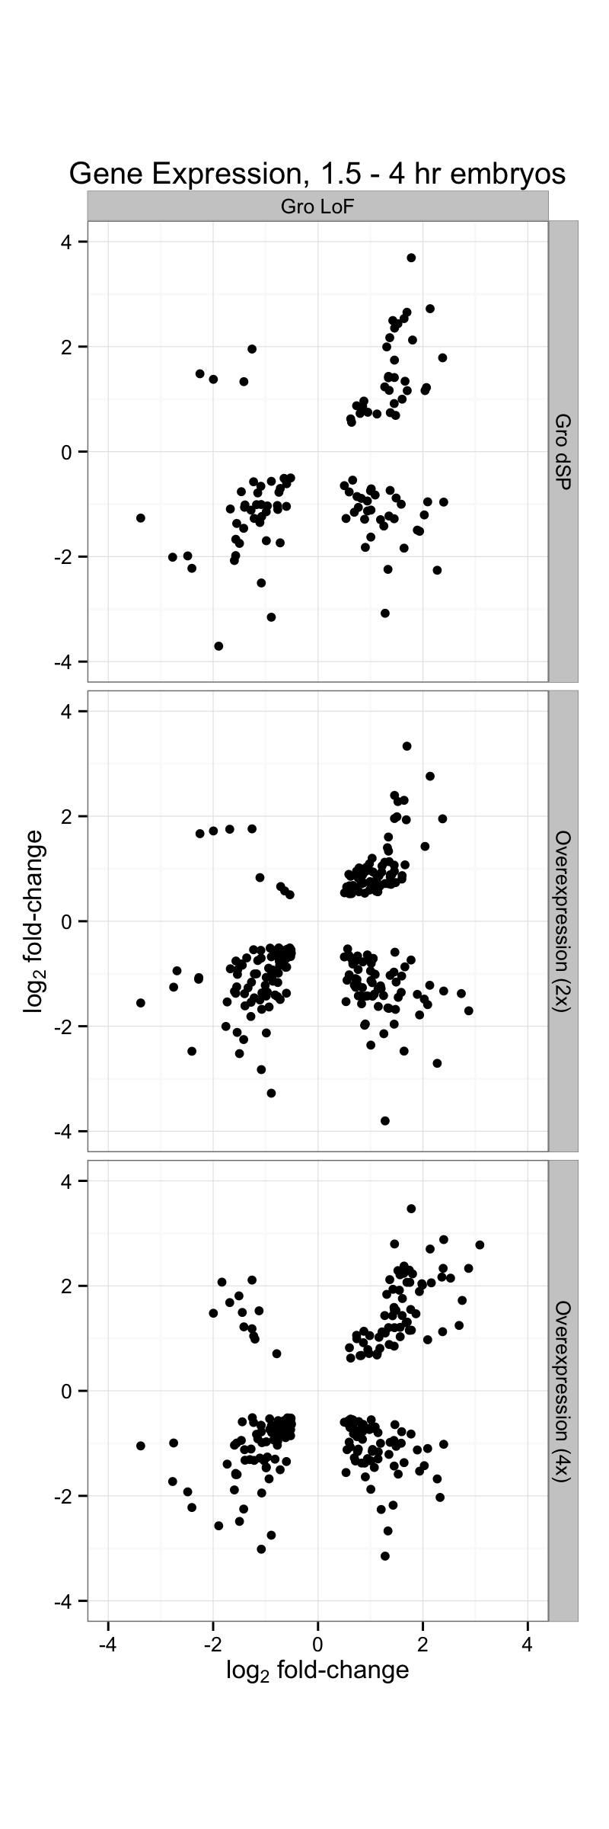
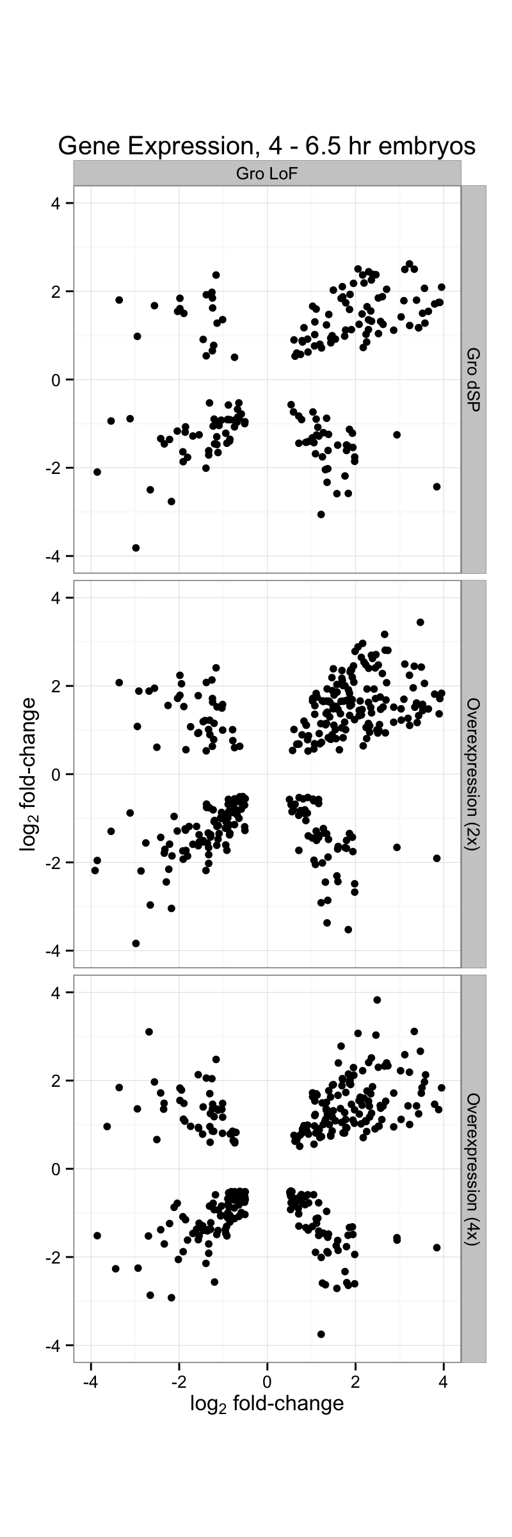
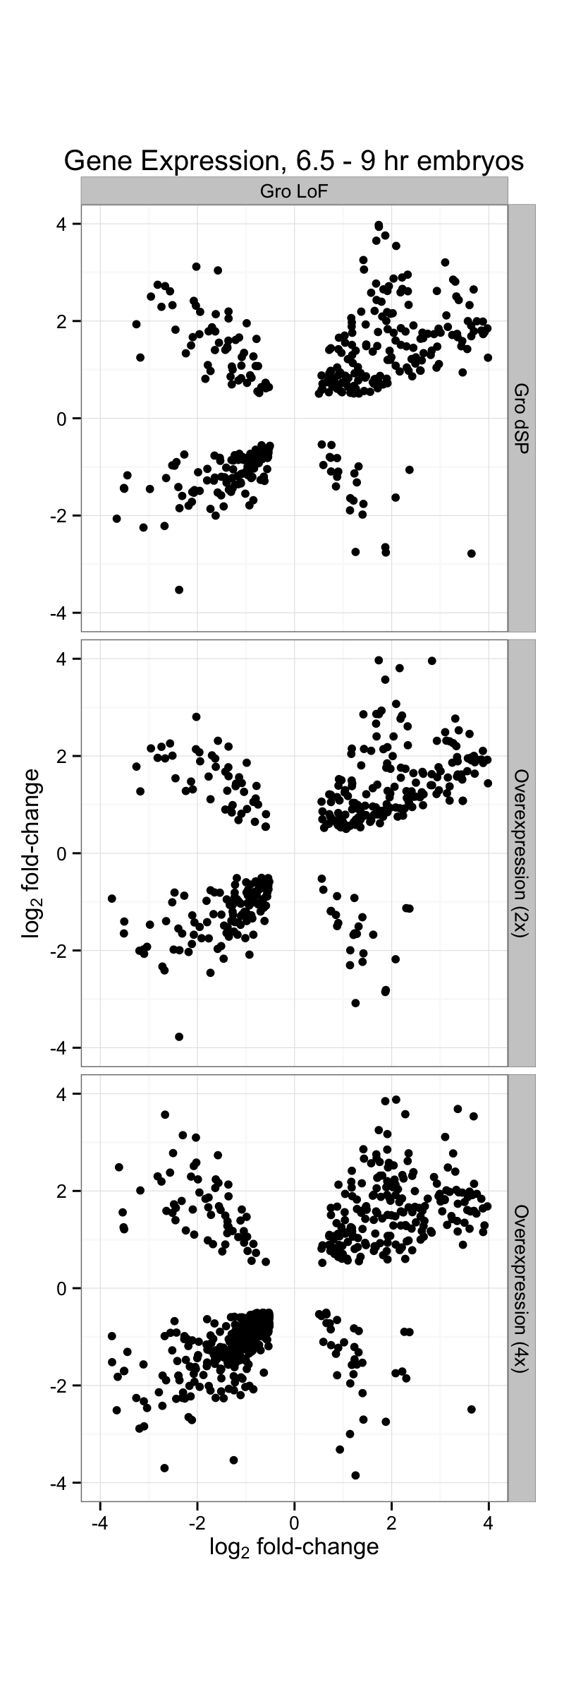

Slide 23
Gro loss-of-function
vs.
2x Gro Overexpression
Gro loss-of-function
vs.
4x Gro Overexpression

Slide 24
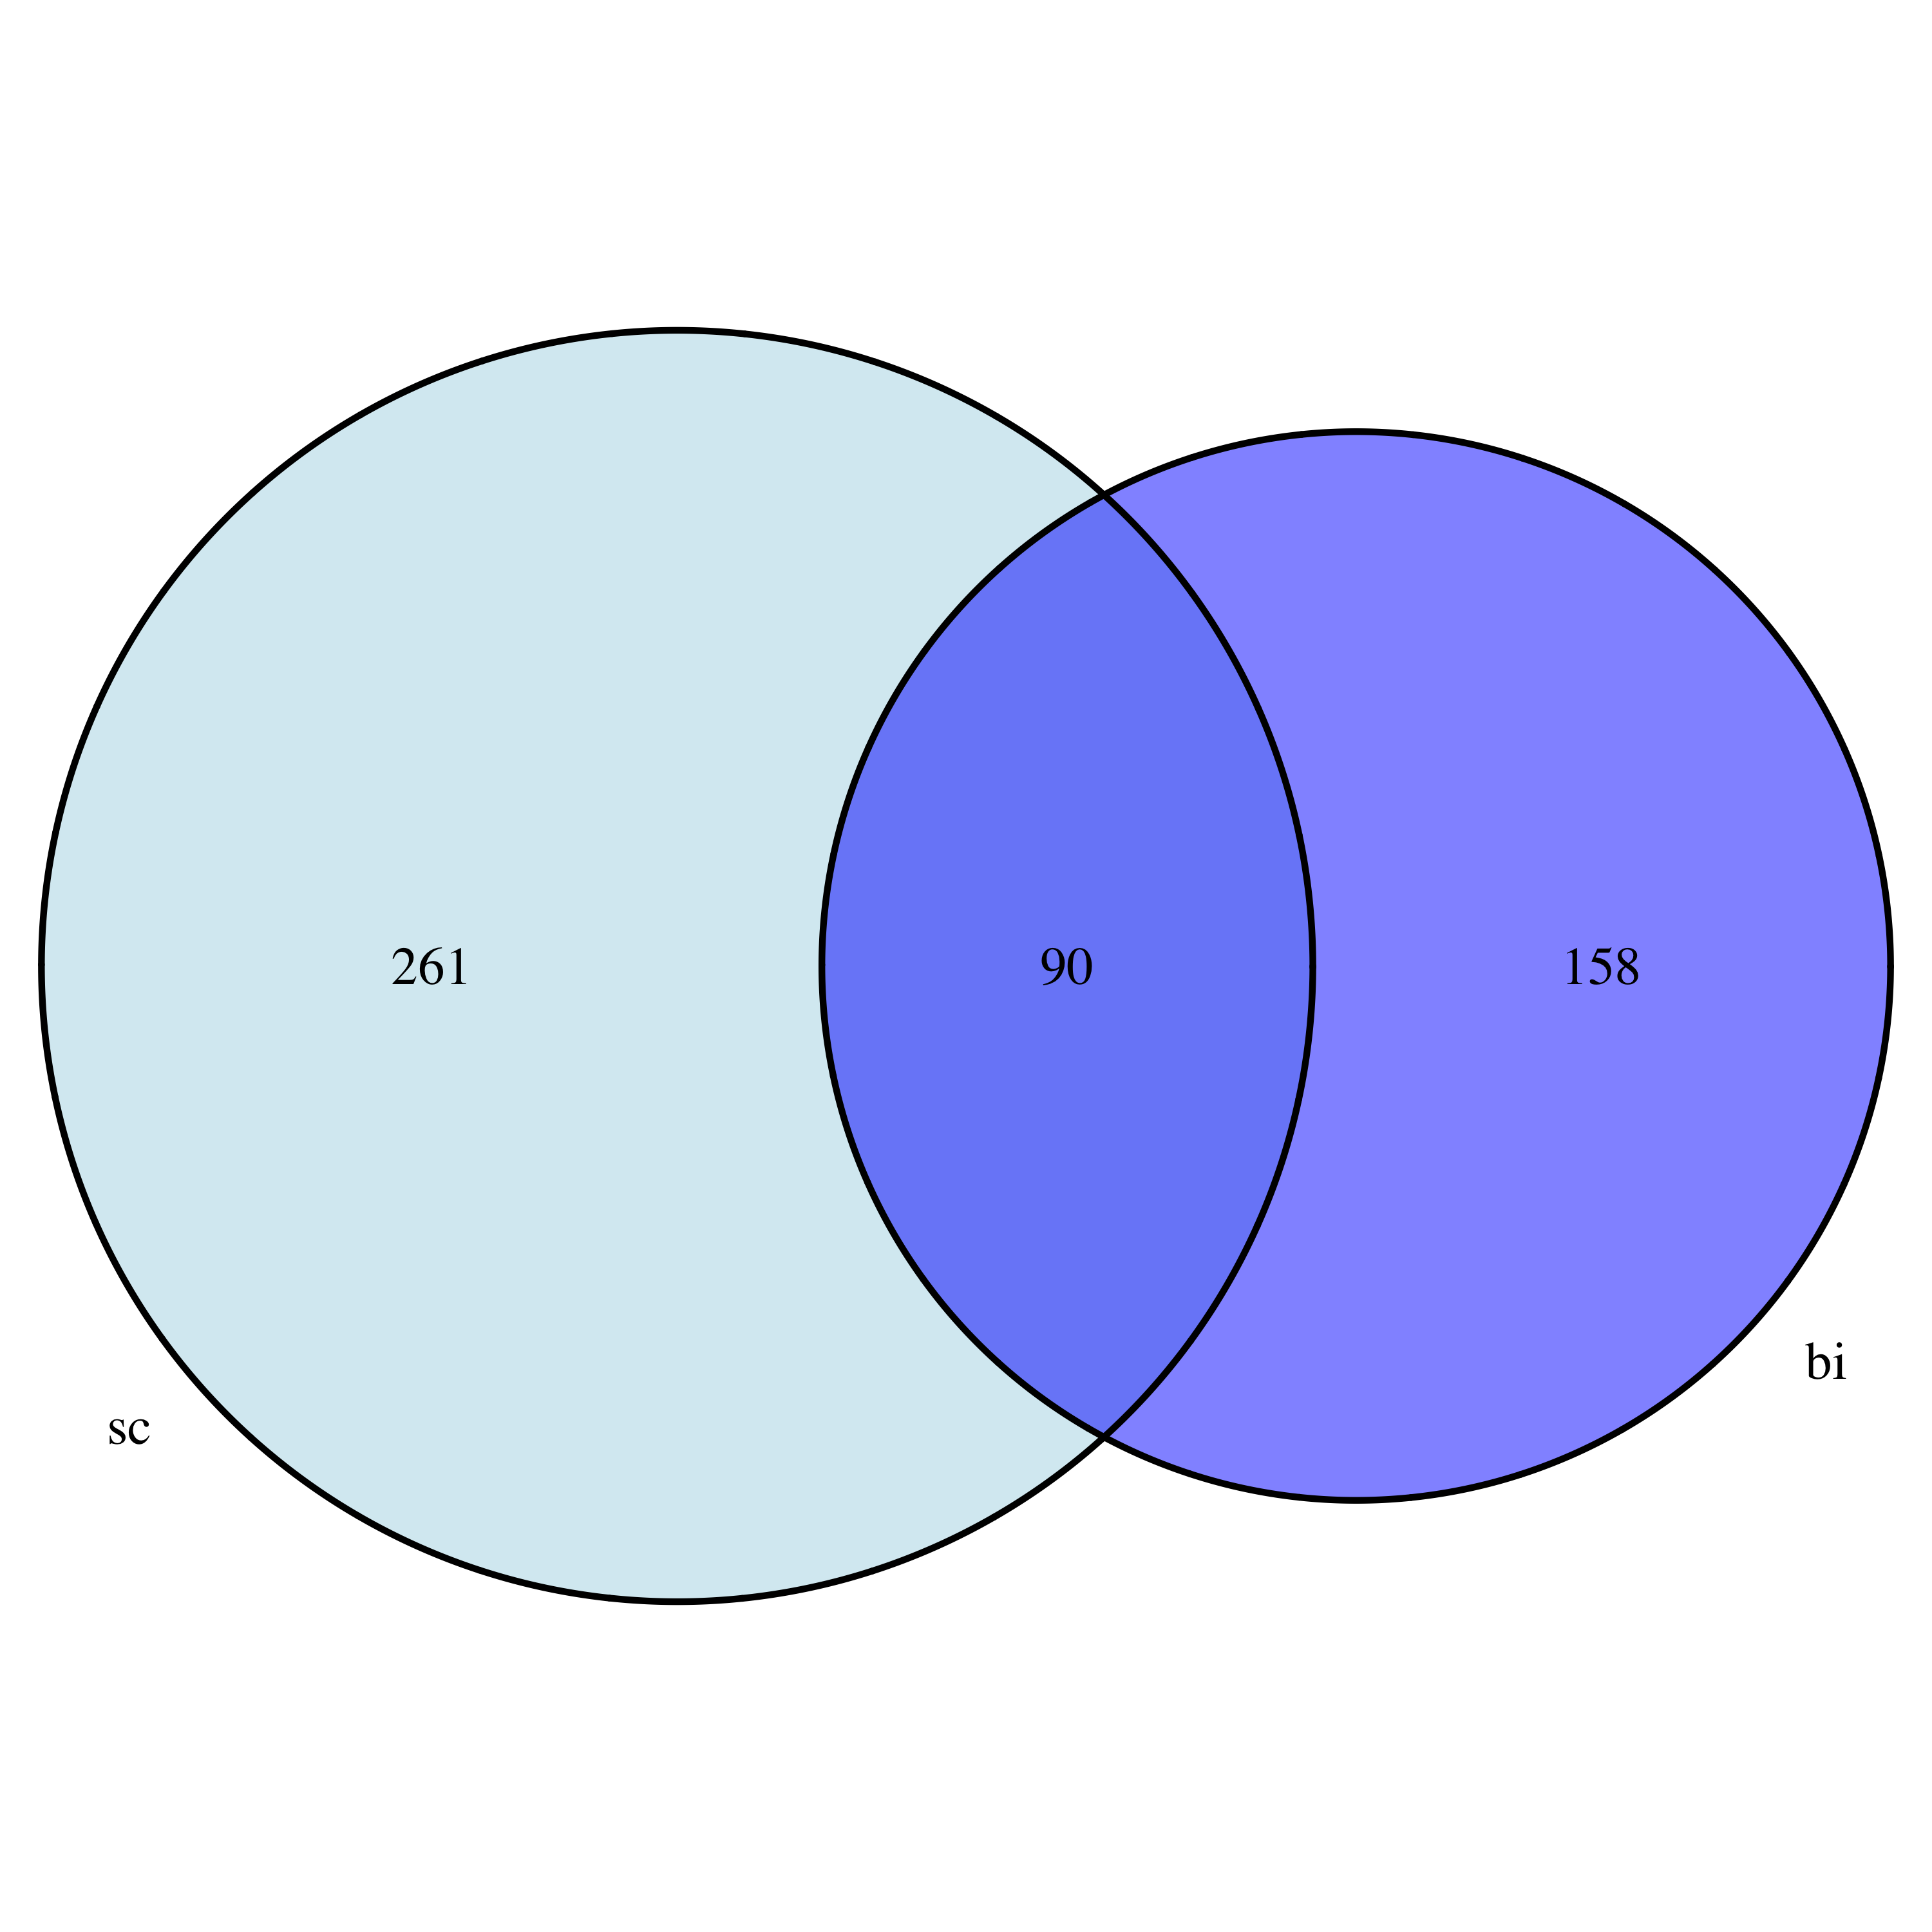
Genes above Groucho occupancy
score cutoff
Groucho Dosage Sensitive
And
Groucho Bound Genes

Slide 25
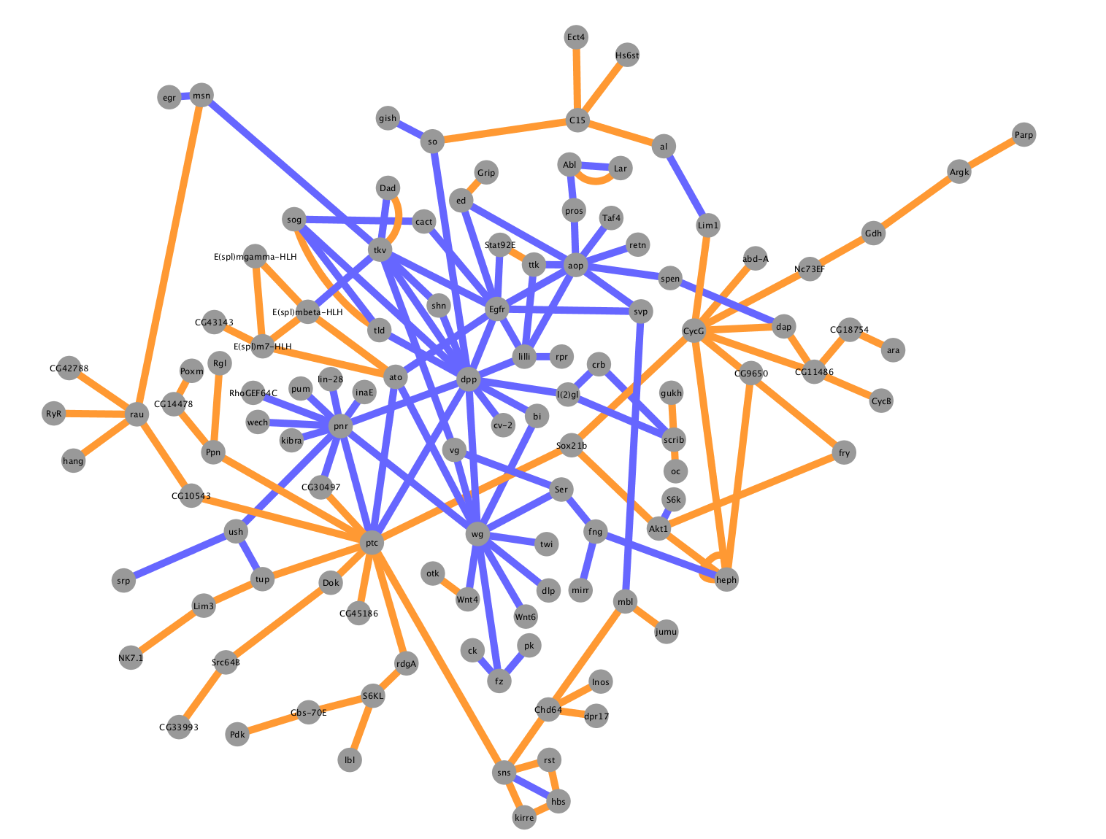

Slide 26
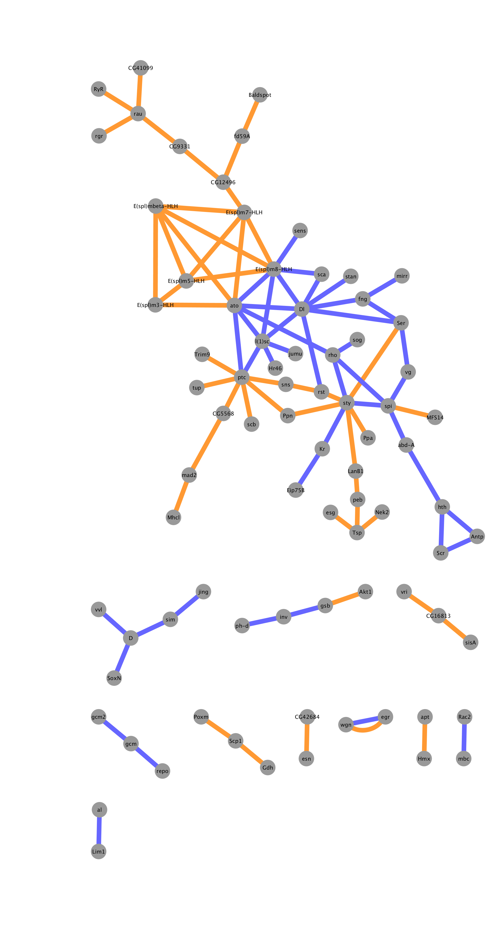

Slide 27
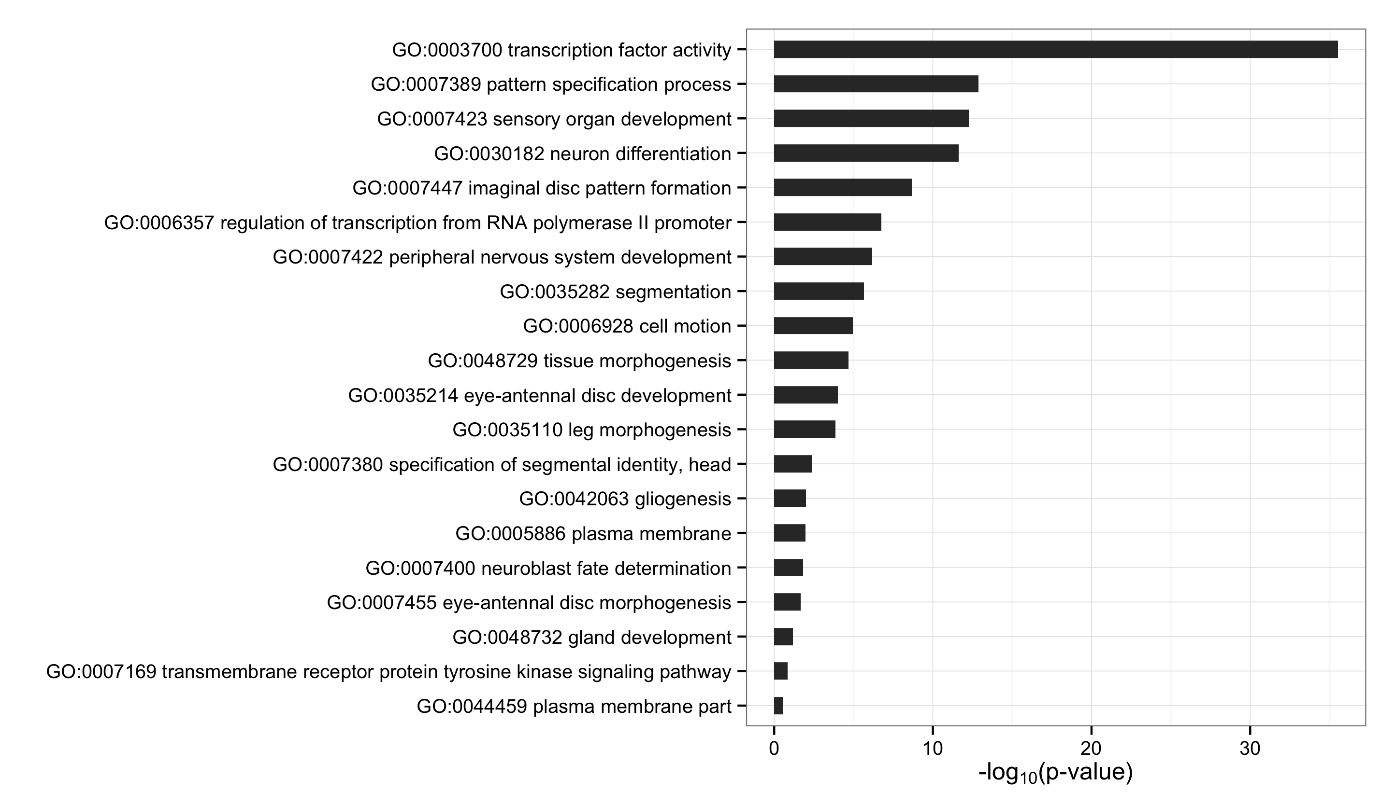
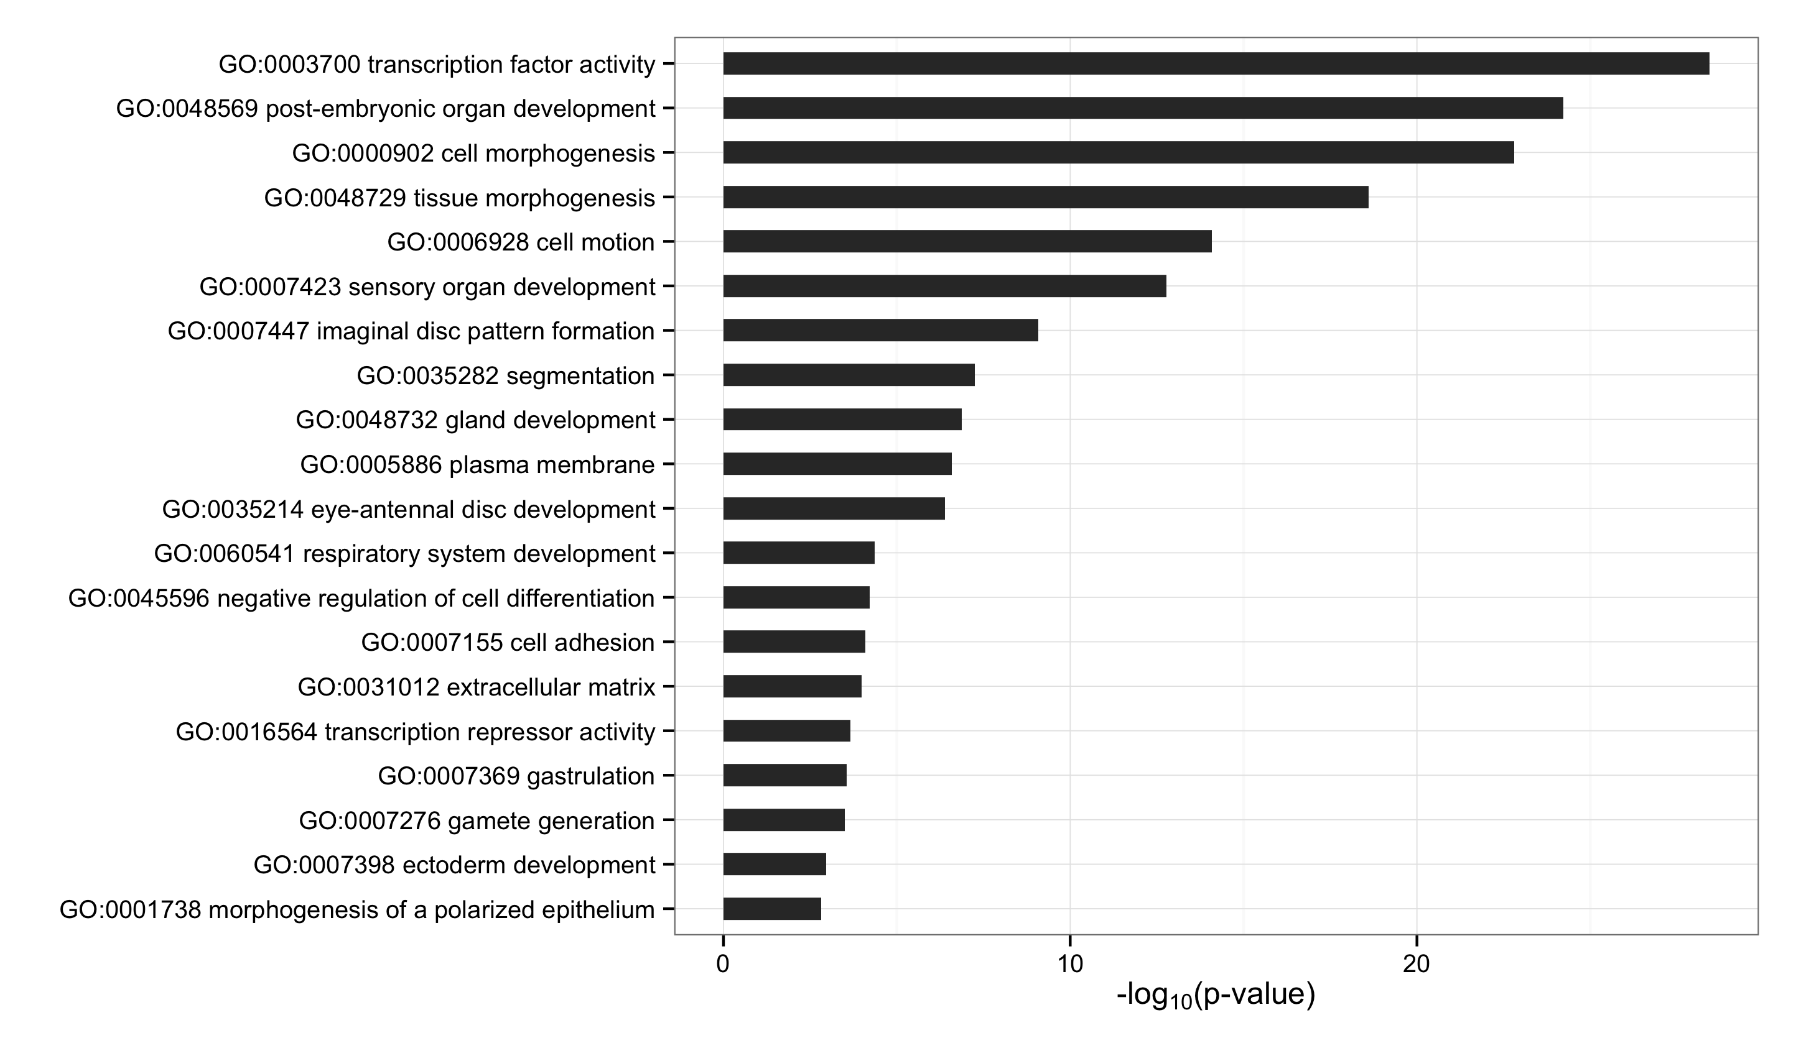
Groucho Dosage Sensitve
Groucho Occupancy Score

Slide 28
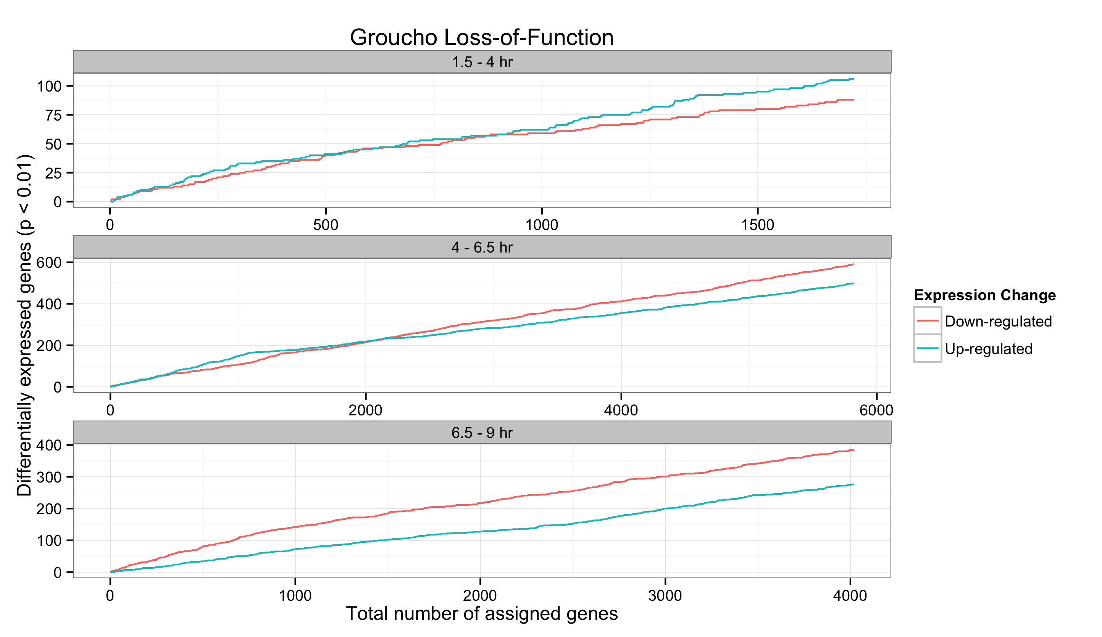
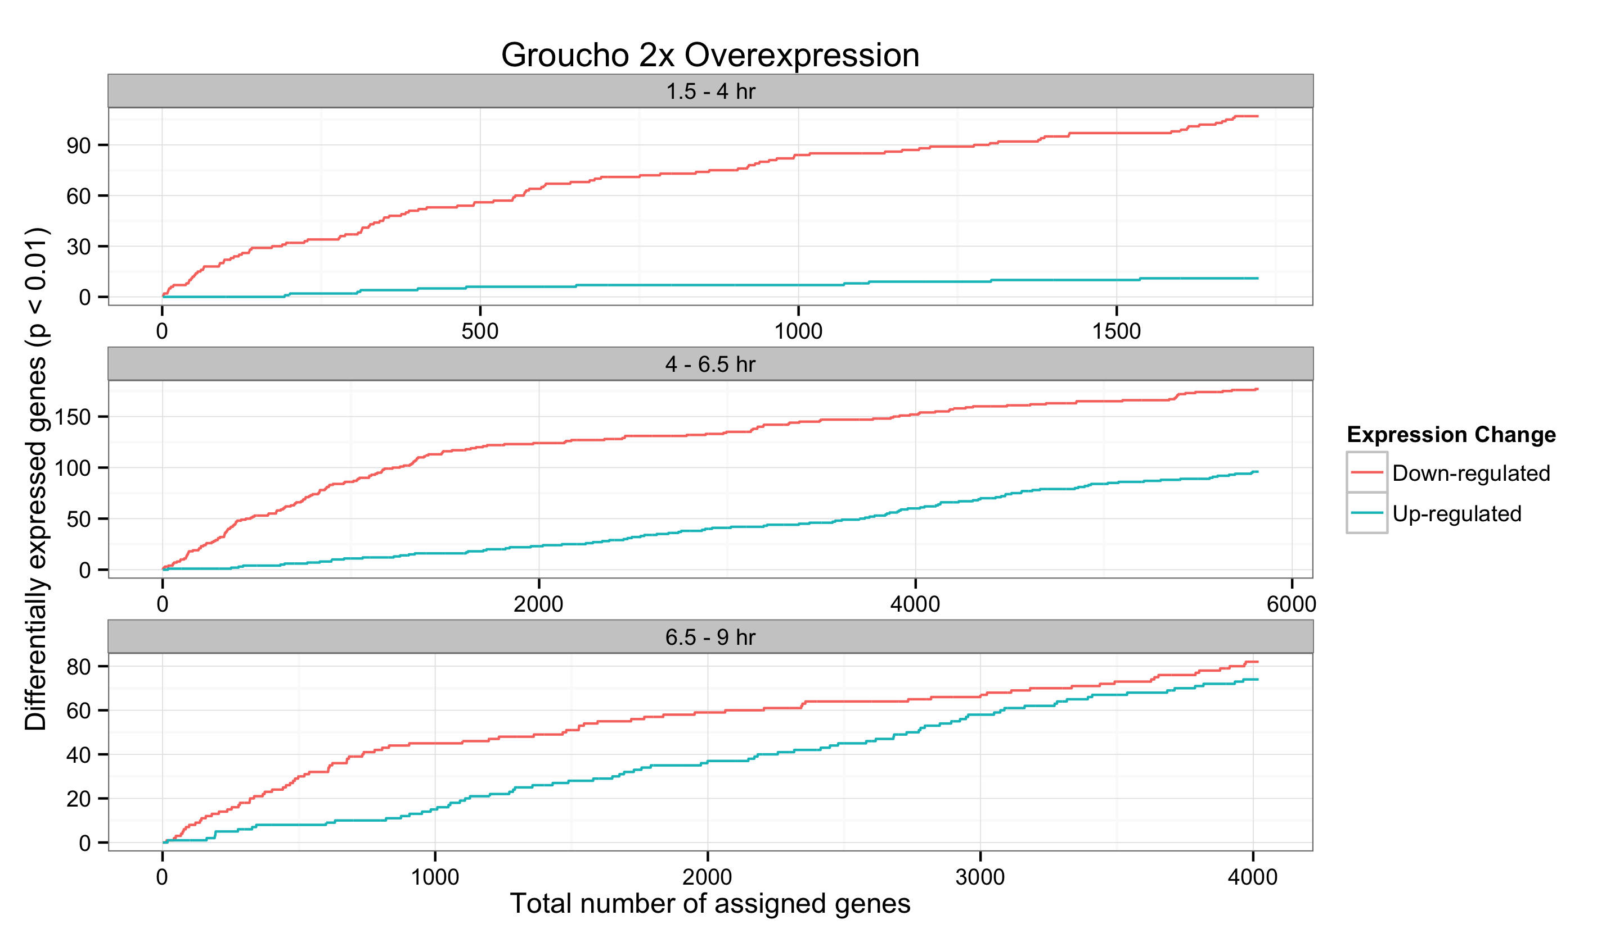
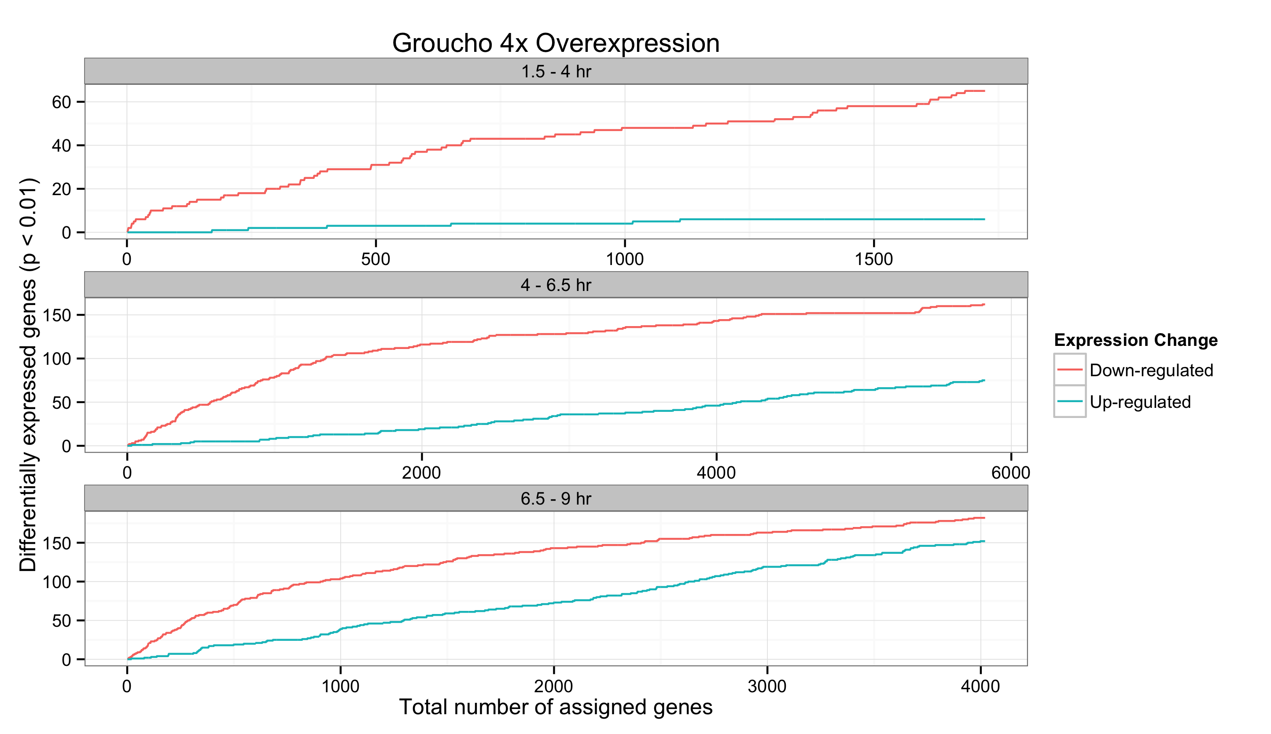
A
B
C

Slide 29
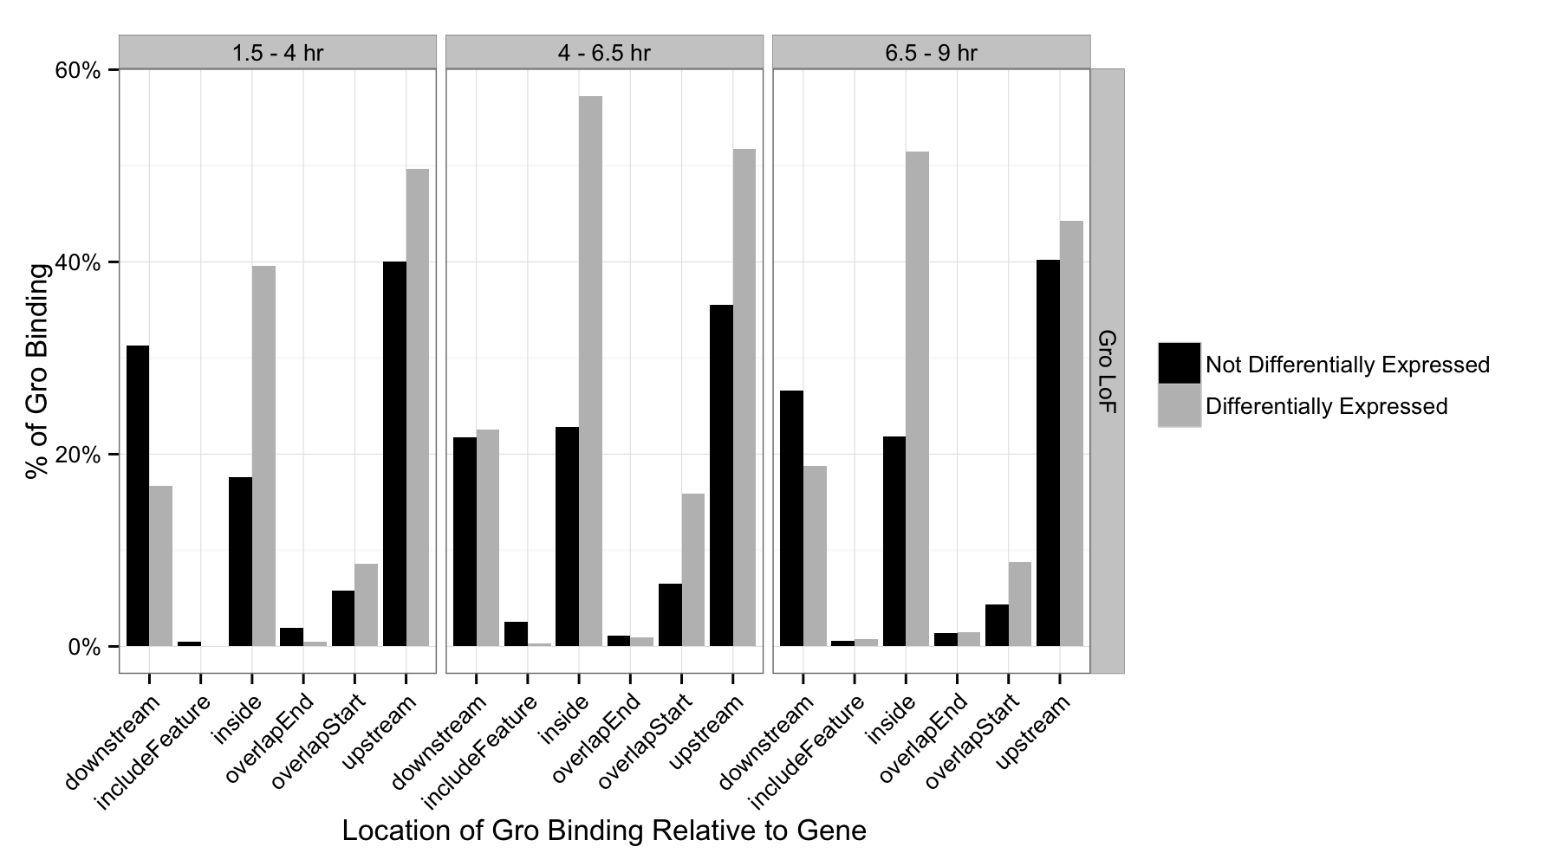
Percentage of genes with internal Groucho binding

Slide 30
z-score
Anterior-posterior
*
*
*
*
*
Dorsal-ventral
*
1.5 – 4 hr
4 – 6.5 hr
6.5 - 9 hr

Slide 31
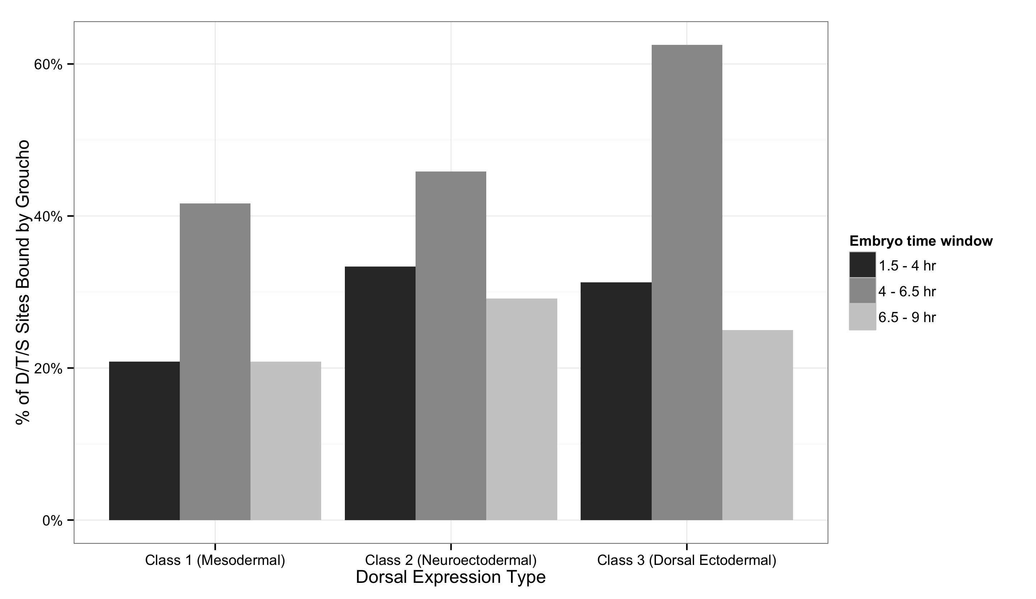
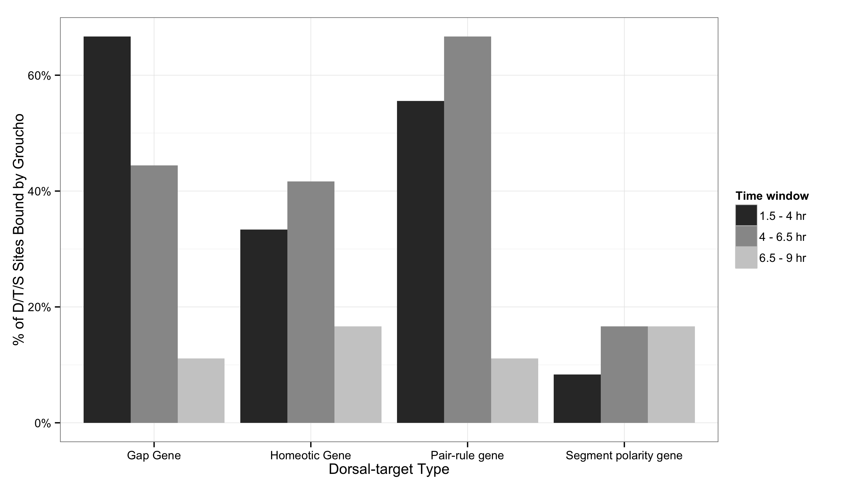
A
B

Slide 32
